Slide 1
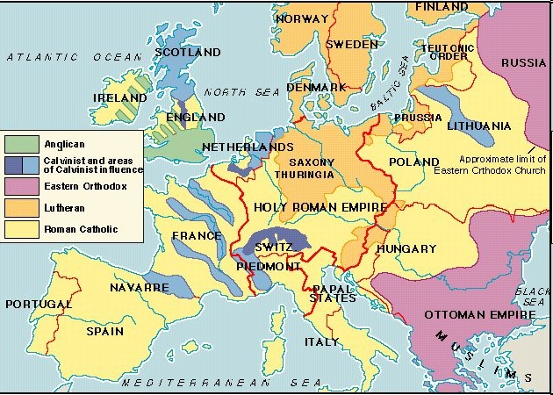
Religious War in Europe: 16th & Early 17th c.
The Blending of Politics and Religious Faith

Slide 2
Religious Struggle, again…
Peace of Augsburg (1555)
Cuius regio, eius religio
Lutherans accepted, Calvinists denied
Catholic Counter-Reformation
Council of Trent confirms RC doctrine
Jesuits lead movement to regain RC losses
Baroque
RC art, music & architectural movement
Connect & elevate worship
Politique… a new type of leader

Slide 3
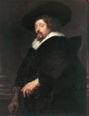
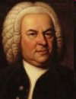
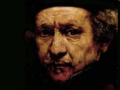
Baroque: A Grand Expression
Art
Rubens, Bernini (RC)
Rembrandt (P)
Music
Bach
Architecture
Ornate, Gilded
Glory to God!

Slide 4
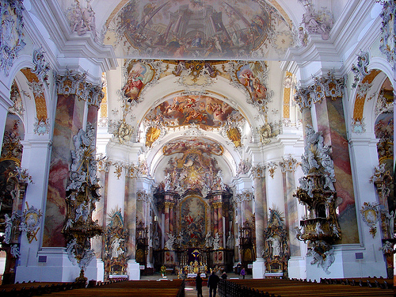
Baroque Architecture: Glory to God!

Slide 5
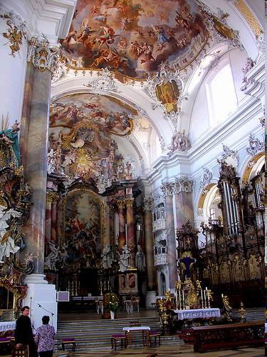
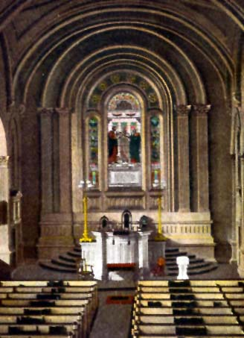
RC Baroque v. Prot Realism

Slide 6
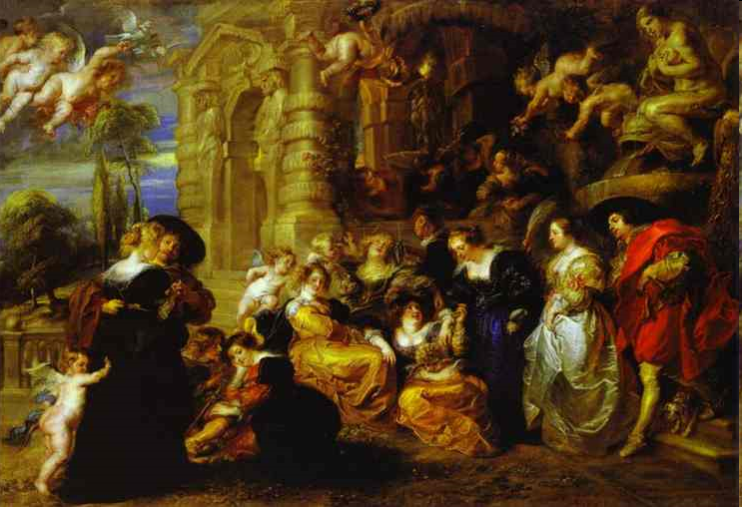
RC Baroque v. Prot Realism

Slide 7
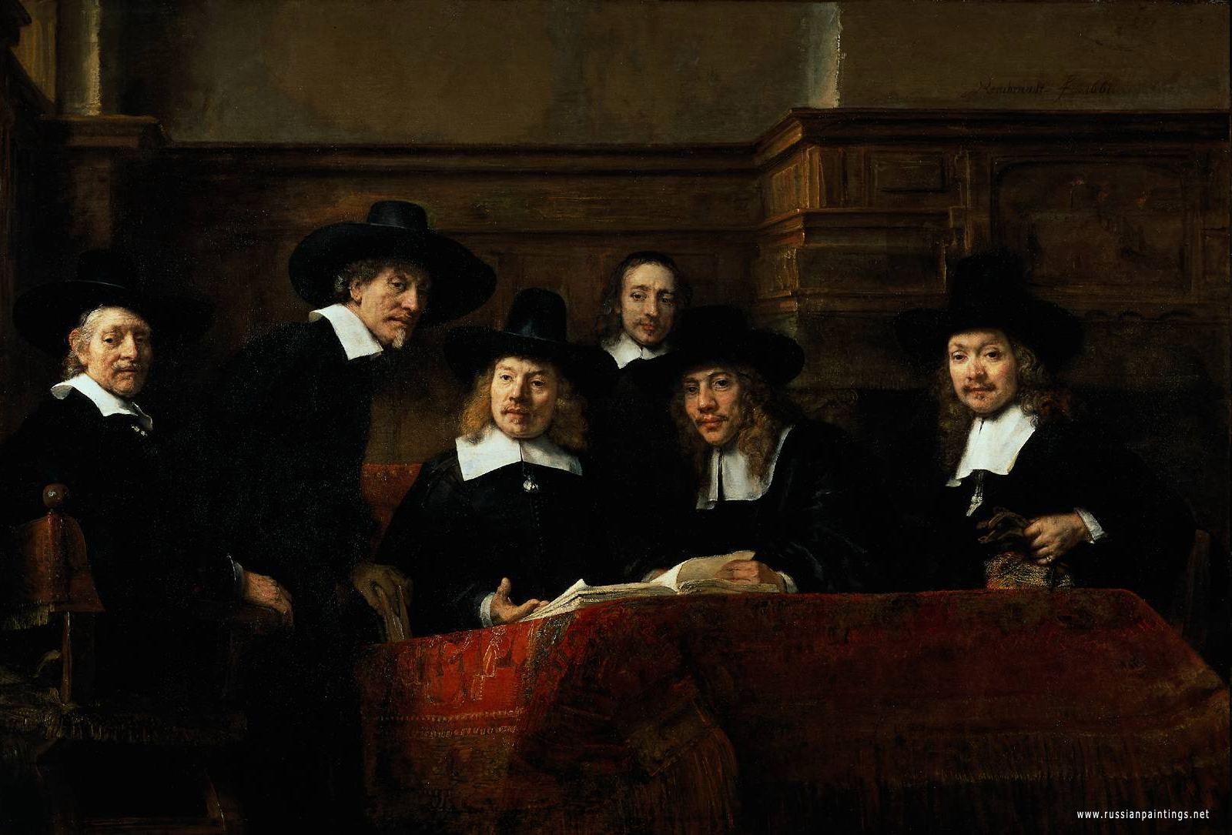
Protestant Realism in Art

Slide 8
The Politique: A New Type of Leader
Skeptical of strict religious dogma
Separate & subordinate religious doctrine from politics
Tolerance
Moderation
Compromise

Slide 9
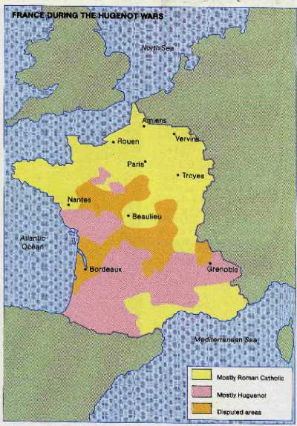
French Wars of Religion
The Huguenot minority
French Calvinists
Persecuted by RCs
Aristocrats + Bourgeois
Faith + Organization + Politics = Power
Edict of Fontainebleau (1540) = Inquisition v. French Protestants

Slide 10
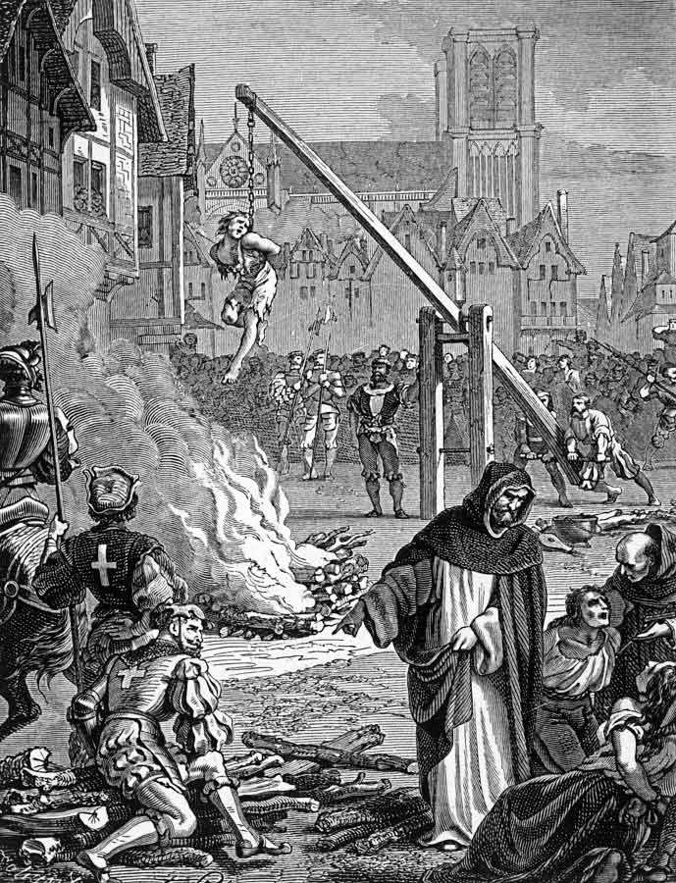
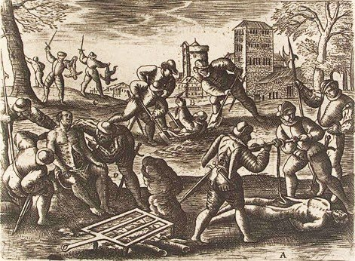
Persecution of Huguenots in France

Slide 11
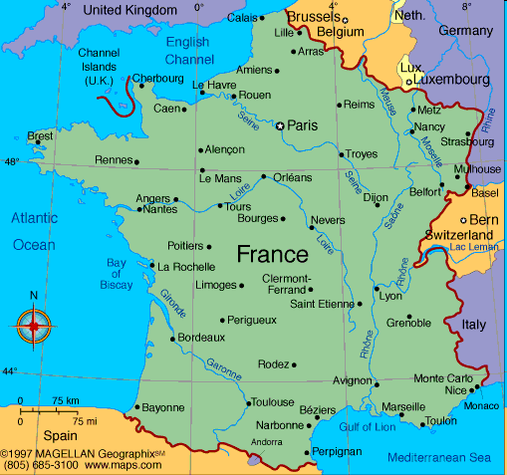
Family Feud: French Style
Death of Henry II (Valois) – oops
Francis II (Valois)
Young (15), weak, husband of Mary QS (18)
Guise (RC + East)
v.
Bourbon (S + W)
v.
Montmorency-Chatillon (Central)
Francis II dies >>
Charles IX (V) + Queen Regent

Slide 12
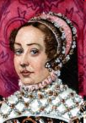
Catherine de Medici: Queen Mother
Poissy Meeting: Reconcile P <> RC… ☹
January Edict [1562]
Limited Freedom for Huguenot (P) Worship
Massacre at Vassy [1562]
Guise led >> RC War v. Huguenots (P)
Royal family co-op’s w/ Guise
Peace of St. Germaine-en-Laye [1570]
Huguenot nobles gain recognition… Gaspard de Coligny ↑↑
Huguenot religious freedom, town fortification
Catherine’s task to maintain control & Crown
Balance Huguenot v. RC Power… Machiavelli?

Slide 13
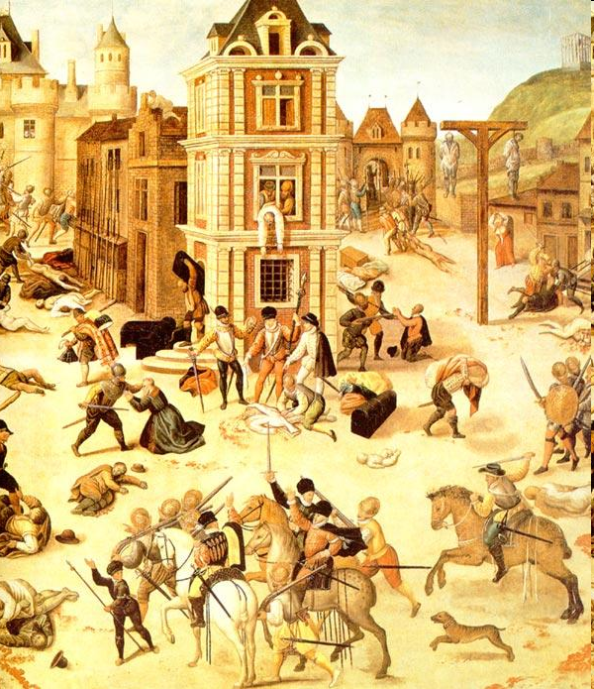
St. Bartholomew’s Day Massacre

Slide 14
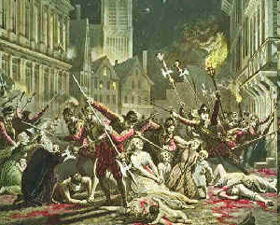
St. Bartholomew’s Day Massacre
Coligny (H) advisor to King Charles IX +
Guise (RC) attempt murder of Coligny (H) +
Henry of Navarre weds Princess Marguerite
= Catherine QM authorized attacks >>
Massacre of 3000+ Huguenots…
Celebrated by RC leaders…
Expands quest for religious freedom

Slide 15
Protestant Resistance: French Path
Beginnings… Biblical acceptance of earthly authority, accept + obey
Next… Publications + protest
St. Bartholomew’s Day Massacre
Next… Protection + defense
Next…Christian duty to overthrow tyrants
Beza, du Plessis Mornay, Knox

Slide 16
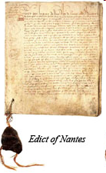
Henry of Navarre: Politique
Henry III (Valois) + Henry of Navarre
Attack Guise (RC)… Henry III dies.. Succession?
Henry IV (Navarre)…
Spain + Papal States prep to attack France
Well liked but… Huguenot as King of France?
“Paris is Worth the Mass” =
Henry IV converts to RC… tolerance!
Edict of Nantes
Truce & Freedoms:
Worship, Assembly, Defense, Education & Jobs

Slide 17
Write an introduction paragraph to the following Free Response Question… underline your thesis…
In what ways were the conflicts in 16th c. France similar and different to earlier conflicts within the Holy Roman Empire?

Slide 18
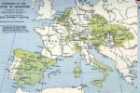
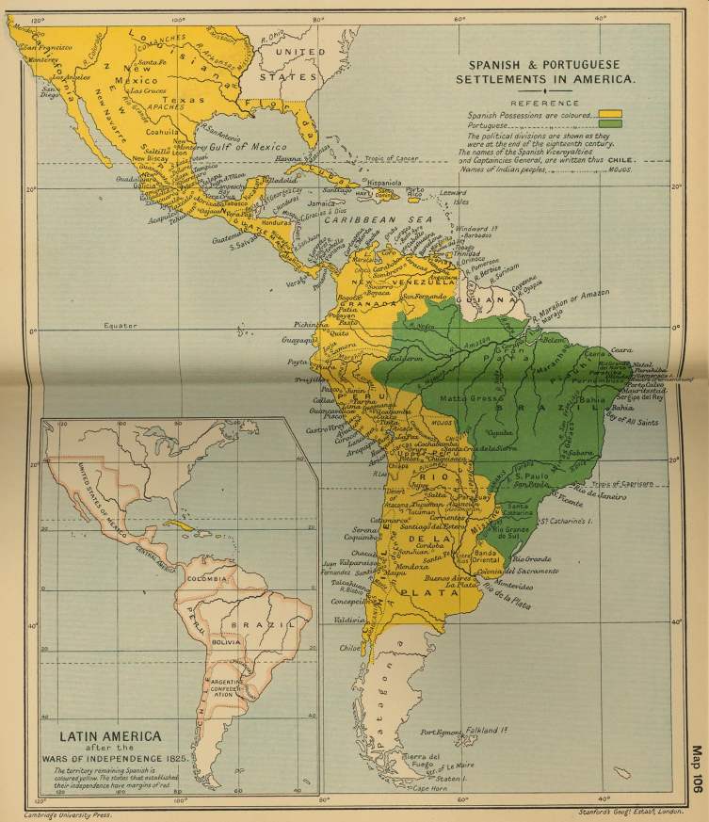
Imperial Spain The 1st Global Superpower
Pillars of Spanish Power
“Fugger” Support (bankers)
New World Riches
Bureaucracy
Homogenous Nation
Mediterranean Domination
Don John @ Lepanto
Problems?
Inflation + Debt

Slide 19
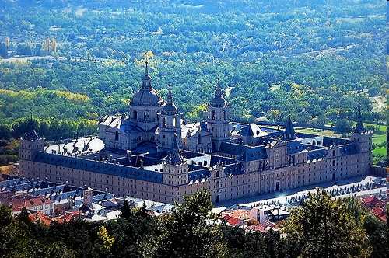
Imperial Spain: Philip II
Devout RC + Defender of RC
Anti-Protestant / Anti-Muslim
Hard-working + Suspicious
Micro-manager, Written Orders
Escorial
Seized Portugal
Patron of Arts
Wealthy!

Slide 20
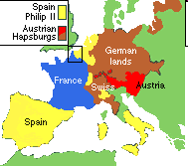
Spanish Netherlands
Dutch Merchants & Traders… $$
Autonomous
Protestant, Jewish & RC… Tolerant

Slide 21
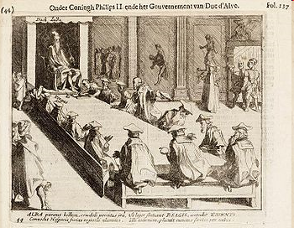
Dutch Revolt v. Spain: Causes
Margaret of Parma (regent) + Cardinal Granvelle (Sp)
Chose to subdue Dutch autonomy & re-establish RC
Dutch resist: Count Egmont & Wm. of Orange “Silent” >> “the Compromise” rejected by Margaret >> Dutch riots >>
Duke of Alba = HARSH!
Council of Troubles / Council of Blood ruled NL >>
Executions for Heresy +
High Taxes = Dutch ☹☹☹

Slide 22
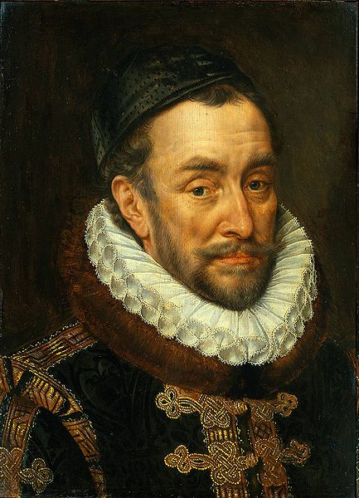
Dutch Revolt vs. Spain
William of Orange… Stadtholder
Calvinist North leads revolt
Sea Beggars (E)
Pirates capture ports >> Dutch rebellion ↑↑
City of Leiden resists Spanish siege
Dikes open = flood >> Survive!
Spanish Fury >>
Pacification of Ghent =
Union of Dutch Calvinist N & RC So.
Dutch defeat Don John >> Perpetual Edict = Sp troops removed!

Slide 23
Dutch Path to Independence
1579 Union of Arras = RC So. peace w/ Spain
1579 Union of Utrecht = Calvinist North unites
Dutch Resistance continues…
Philip II declares Wm. Orange “outlaw”
Wm. Orange denounces Philip II… “Apology”
Wm. Orange assassinated by Sp >> Maurice
E & Fr aid 1580s >> drains Spain $$… 1588?
1593 Calvinist No. drives out Spain, recognized by E & Fr as a nation >> independence 1609 via Twelve Year Truce

Slide 24
Write an introduction paragraph to the following Free Response Question… underline your thesis…
In what ways did religious differences created by the Reformation contribute to Dutch independence from Spain?

Slide 25
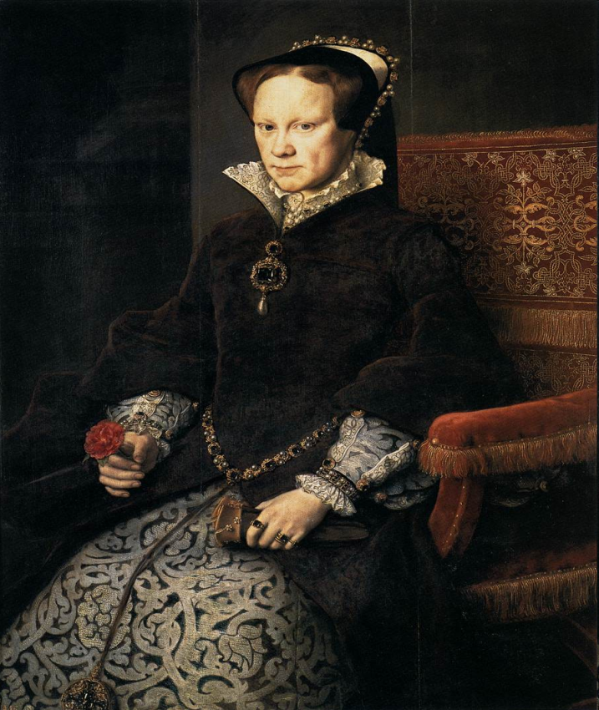
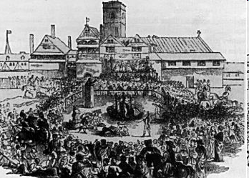
England under Mary I
1554 Married Philip II of Spain
RC union, political marriage, unpopular
Revoked Protestant laws
Executed “heretics”
Bloody Mary
Protestants fled
Marian Exiles

Slide 26
England under Elizabeth I
Reigned 45 Years (1558-1603)
Sir Wm. Cecil advisor
Protestant Politique
Act of Uniformity 1559… practice
39 Articles… Protestantism official!
Puritanism rise
Goal = Purify Anglican Church
Presbyterians follow Calvin structures > Scots
Congregationalists sought independent practice >> America

Slide 27
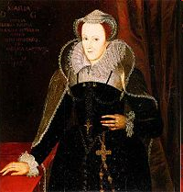
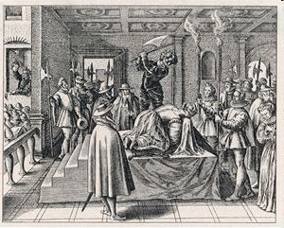
Elizabeth I v. Mary Queen of Scots
Mary Stuart (QS) = cousin, RC
Married Francis II (Fr)… widow
Married Henry Stuart (Scot) aka Lord Darnley… murdered
Married Earl of Bothwell (Scot)
Killer? Fled to E… imprisoned
Babington Plot
Sought to assassinate E
MQS executed for treason
“Regicide”

Slide 28
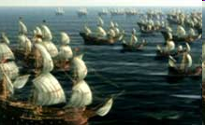
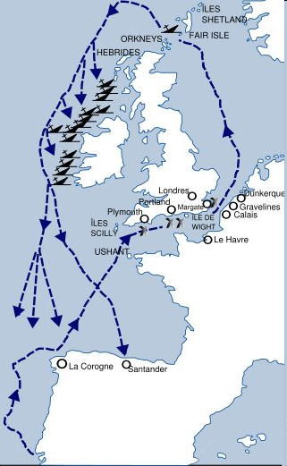
Elizabeth I v. Spain
Rejects Philip II’s marriage
Excommunicated 1570
E + F defensive alliance 1571
Sir Francis Drake… pirate?
Aid to Dutch v. Spain 1580s
Executes Mary Stuart (RC)
Sir Francis Drake >> Cadiz
Spanish Armada defeated
English Channel 1588

Slide 29
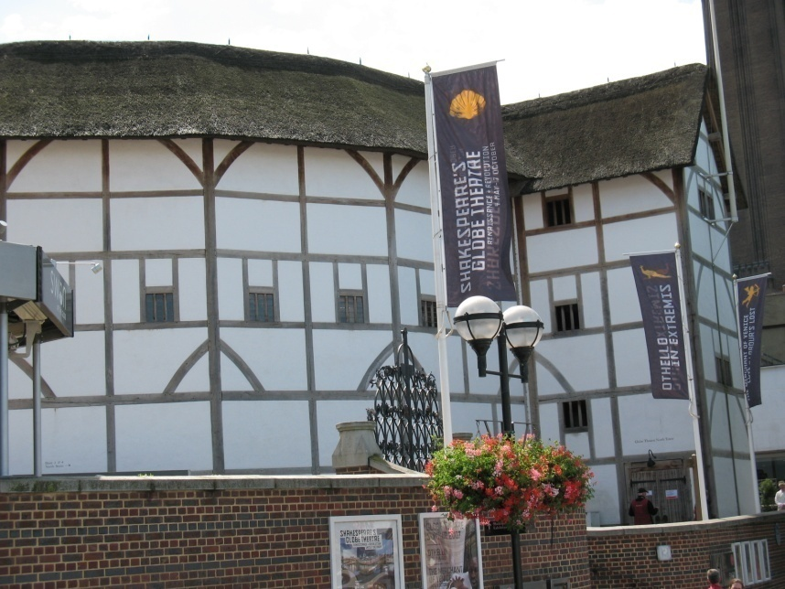
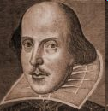
The Elizabethan Age
Theatre
All male actors
Shakespeare
Globe & Rose theatres
Entertainment & Education
Morality plays
Tragedy – Comedy – Drama
Women… No Rights

Slide 30
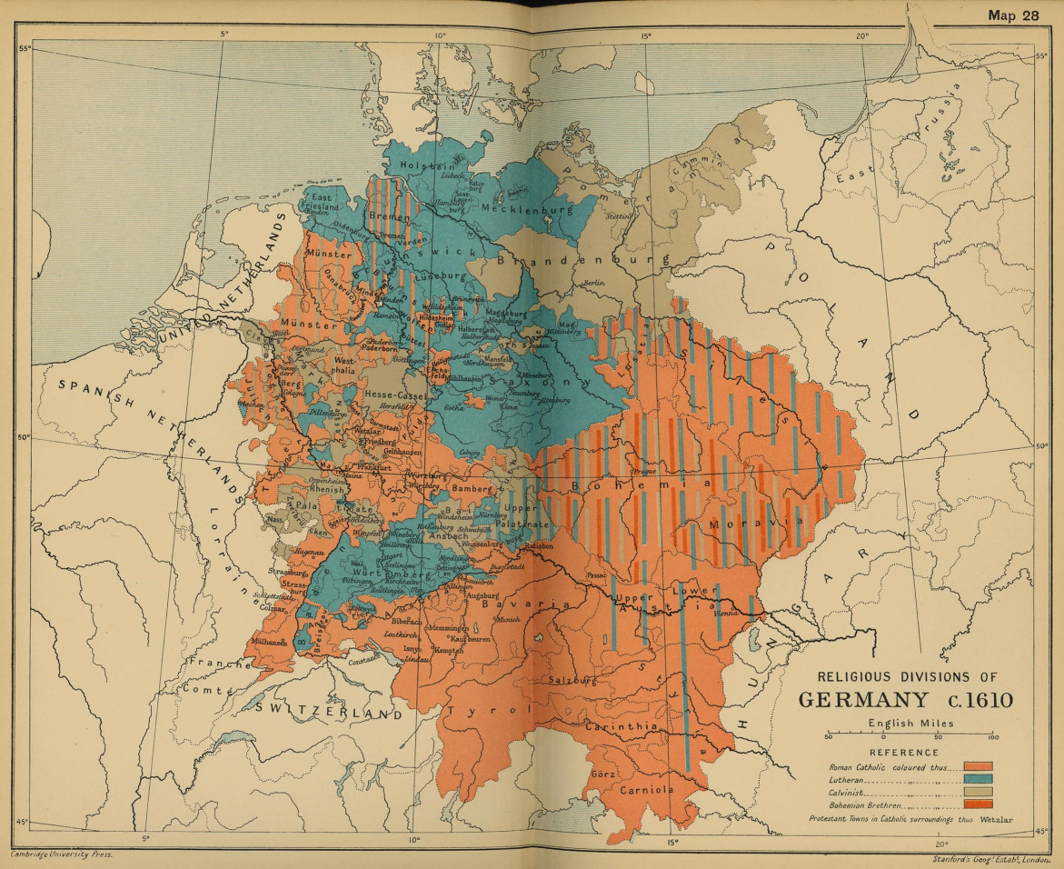
The Thirty Years War: Why?
German areas fragmented
300+ mini-states
Territorial mindset
Religious Division
RC v. L vs. C
Calvinism spreads
Missionary activity: RC & C
Alliances
Catholic League by Maximilian I (Bavaria)
Army formed… Count J von Tilly

Slide 31
30 Years War
Bohemian Phase
Danish Phase
Swedish Phase
French Phase

Slide 32
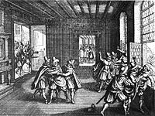
30 Years War: Bohemian Phase 1618-25
Ferdinand (Hapsburg) >> King of Bohemia
RC > Revoked Protestant freedoms, ↑↑ taxes… ☹ ☹
Defenestration of Prague
Bohemian Protestants toss out RC regents
Claim Fred V of Pal as King… ☹ Ferdinand HRE
HRE + Spain v. Bo + Palatinate
HRE (Tilly) def. Bohemians, reclaims both lands

Slide 33
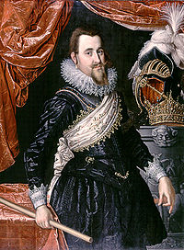
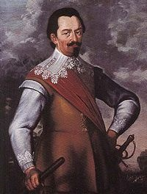
30 Years War: Danish Phase 1625-29
King Christian - L (Denmark)
Lost to HRE Maximilian ☹
A. Wallenstein - mercenary
Attacks & Defeats Denmark
Edict of Restitution 1629 ☹
Calvinism illegal
Return of RC lands

Slide 34
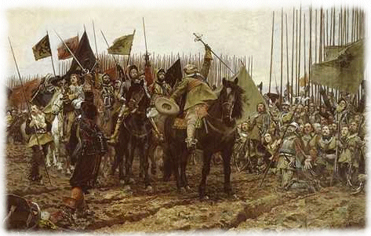
30 Years War Swedish Phase 1630-35
King Gustavus-Adolphus - L (Sweden)
Sw + Brandenburg + Saxony def. HRE
New Tactics “Fire & Charge”
Infantry + Cavalry = mobile
Key Deaths
King G-A
Wallenstein killed
Peace of Prague 1635
Disagreements lead to…

Slide 35
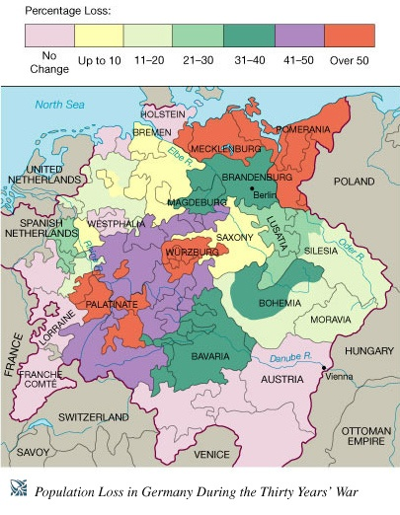
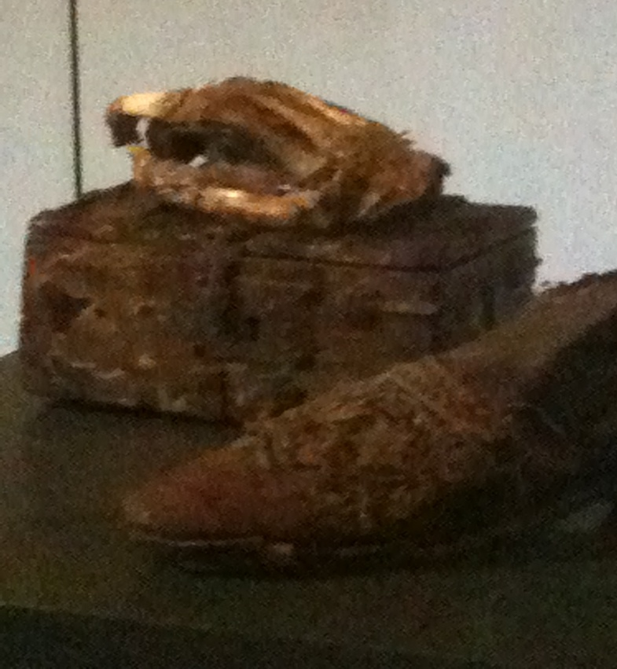
30 Years War: French Phase 1635 - 48
French join Swedes…
War Without Honor
German lands ruined
1/3 pop killed

Slide 36
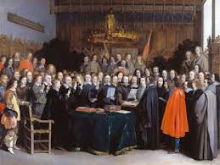
Peace of Westphalia: 1643 – 1648: A Negotiated Peace = Diplomacy

Slide 37
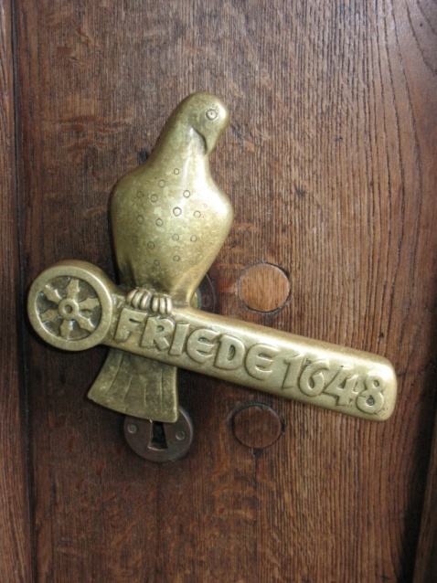
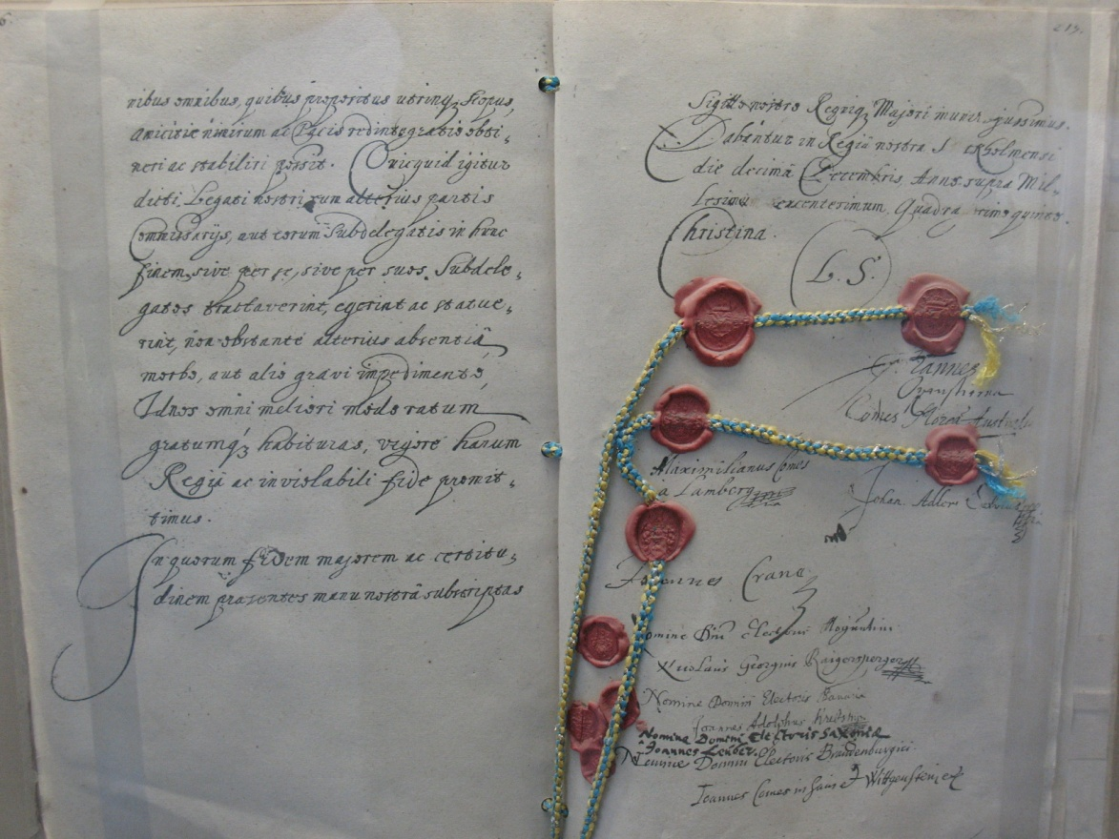
30 Yrs War: Peace of Westphalia 1648
Peace of Westphalia: 1643-1648
Written in French = French Power ↑↑
Negotiated in Műnster (RC city)… NL + Sp plus HRE + Germans AND Osnabruck (L city): HRE + Sw + Germans
Why there? Close + Infrastructure
Ends Edict of Restitution
Calvinism made “legal”
Swiss & Dutch = Sovereign States!
Prussia ↑↑ / France ↑↑ / G divided
1st time war in Europe ended by diplomacy! Balance of power idea ↑↑

Slide 38
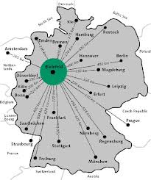
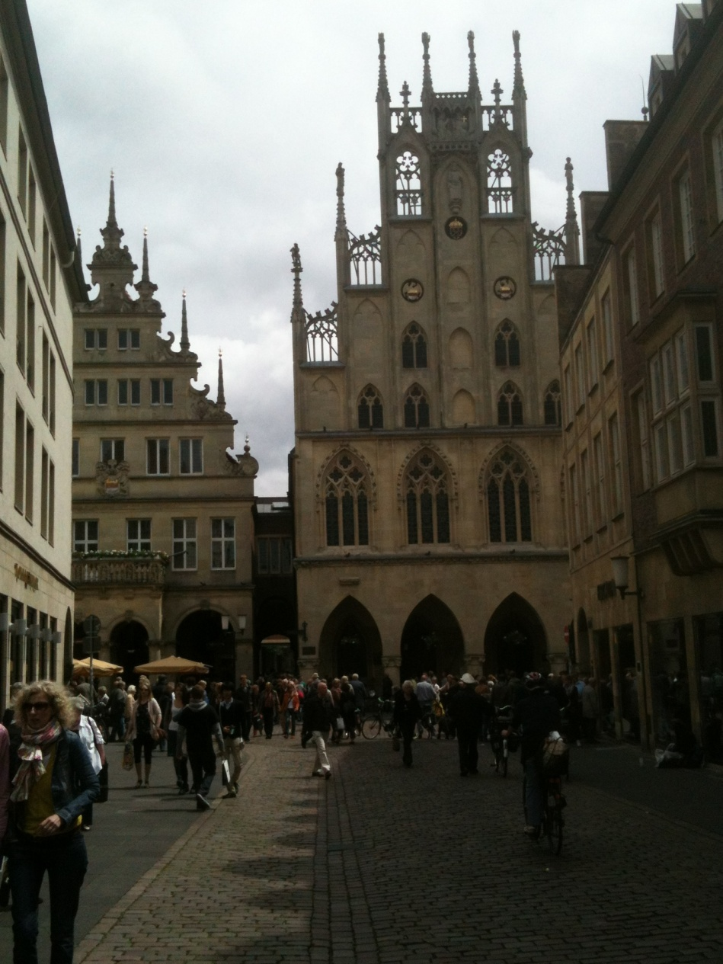
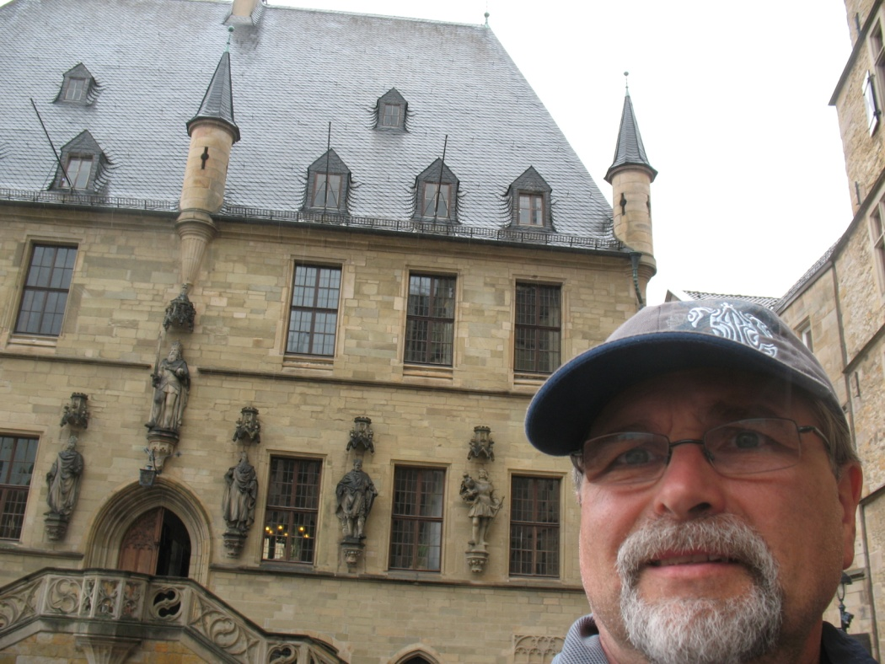
Peace of Westphalia: Signed 1648
Muenster
Osnabruck

Slide 39
Write a thesis & bullet evidence…
How did the Thirty Years War and its outcome change European religious and political power structures?

