Slide 1
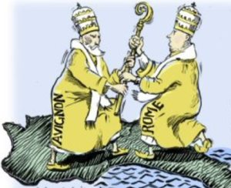
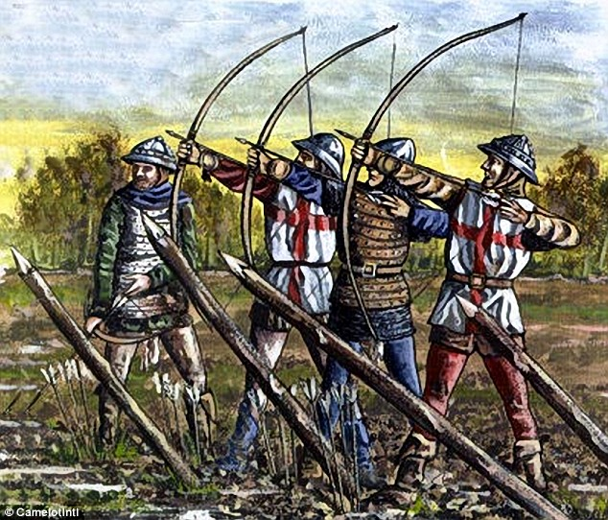
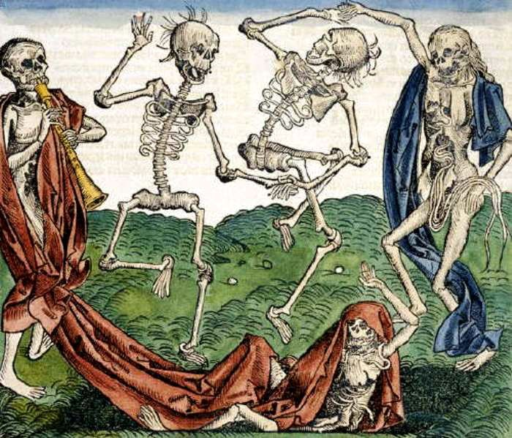
The Late Middle Ages
Crisis in the 14th Century: Disease, War & Division

Slide 2
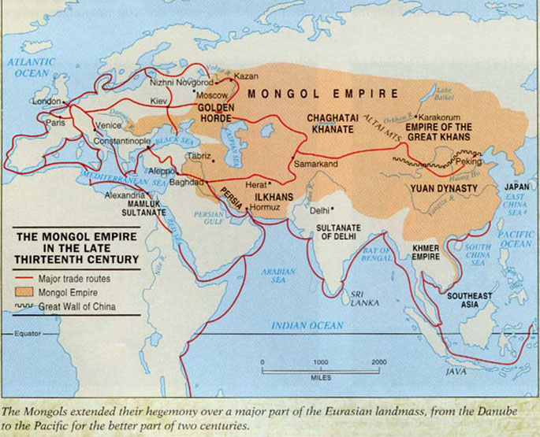
Black Death: Precursors
High Middle Ages = Stability > growing population > overpopulation, food?
Climate Change > Famine > Health Risk
Bubonic Plague spreads from Asia: Silk Road Trade + Mongol expansion

Slide 3
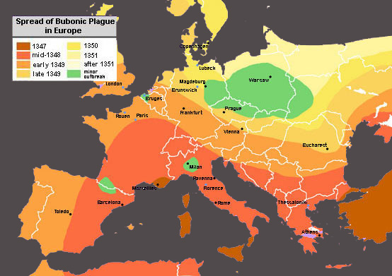
Black Death Direct Causes & Rapid Spread
Infected fleas + rats >> infected people
Increasing urbanization spread disease
Lack of immunity >> DEATH!

Slide 4
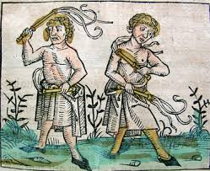
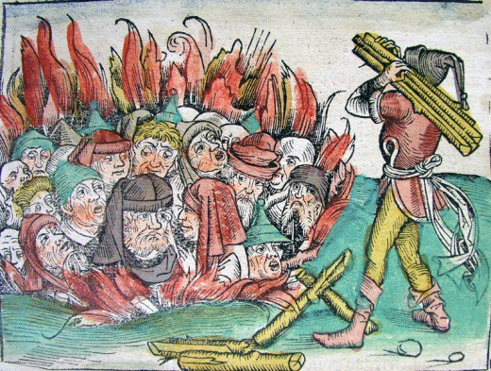
Black Death: Why? Reactions
It must be GOD’s punishment > Asceticism + Flagellants…
It must be bad air & vapors released by earthquakes…
It must be the Jews >> Anti-Semitism + Pogroms >> Jewish Migration to Poland & Eastern Europe

Slide 5
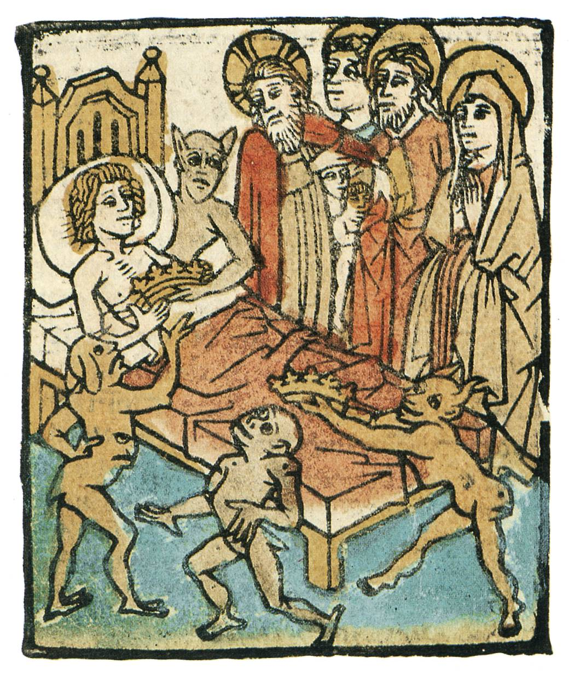
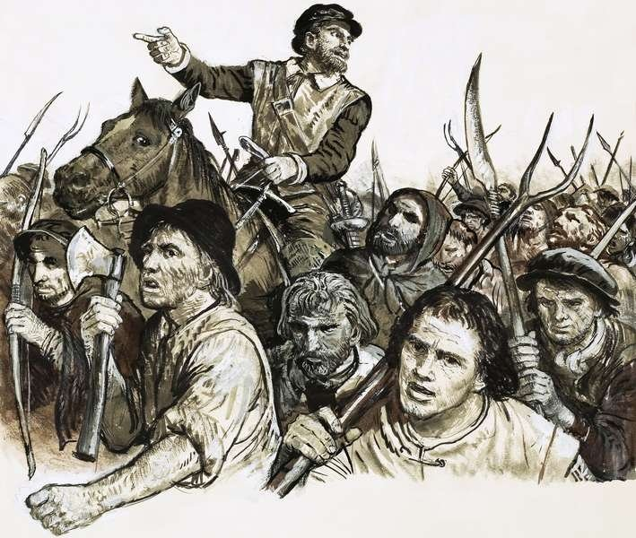
Black Death Impact
Cultural Pessimism
Ars Moriendi (Art of Death)
Social Unrest
Migration: Jews to Poland
Migration: Peasants to towns
RC Church weakened
Class Tensions >> REVOLTS! French Jacquerie, English Peasants, Italian Ciompi
Economic Unrest
Labor shortage = Labor Power ↑↑
English Statue of Laborers (1351) > unrest!
Upper class oppression, taxes >> REVOLTS!

Slide 7
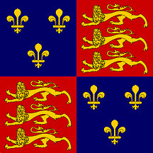
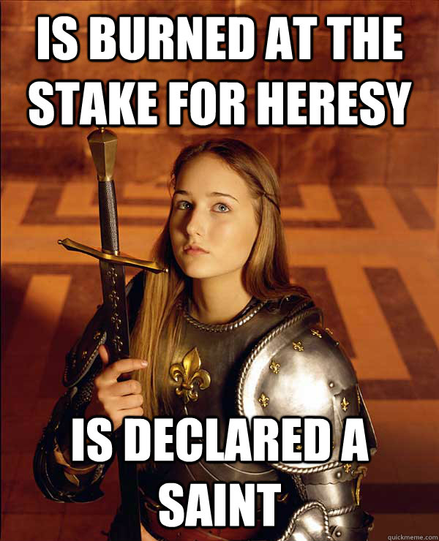
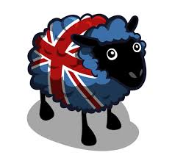
Hundred Years War: Cause, Course & Impact
Causes:
E v F, feudal claims LAND + Throne, E nationalism & human pride
Flanders cloth <> English wool
Course & Key Events:
English Longbow v French crossbow, cannon, destruction in France
Crecy (1346) + Poitiers (1356) + Agincourt (1415) = E wins ☺!!
Joan of Arc @ Orleans = F ☺ victory + inspiration…
Joan of Arc betrayed, French intrigue > Heretic!
Major Outcomes:
E cloth industry ↑,
French nationalism ↑,
Peasant unrest in E & F

Slide 8
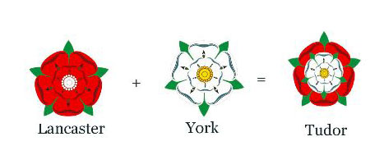
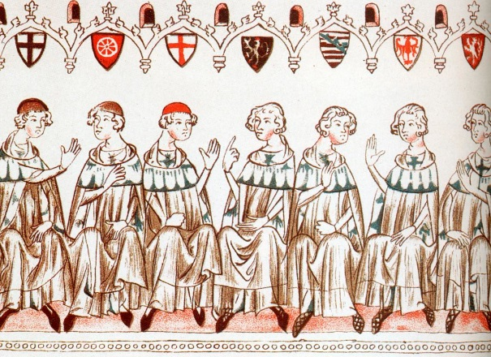
LMA Differences in Political Development…
Who? England, France, HRE, Italy
Common Issues: Feudal Relations (Scutage), Taxation, Leadership
England:
$$ issues > Parliament ↑ “Power of the Purse”
Parliament = Lords (inherited) + Commons (elected)
Dynastic challenge = Lancaster v York “War of the Roses” > Tudor ↑
France:
Area & Family Rivalry = divided nation, weak Estates-General
Unfair taxation = lack of support, unity
HRE: Small states & city-states hold power = Divided nation
HR Emperor = “elected” & princes hold power

Slide 9
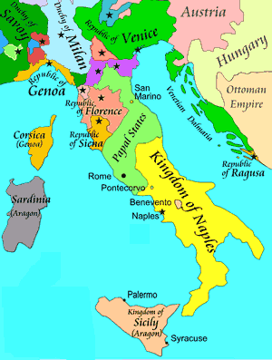
LMA Italian Political Development…
Papacy = Religious + Political
Divided Italy, City-States emerge
Government = Republics or Despots / Tyrants (Power Family in each major area)
Key City-States = Venice, Milan, Florence, Naples, Papal States…
Florence: Republic > Popolo Grosso v. Minuto > Oligarchy
Medici Family dominates… banking, trade, RCC
Venice: Republic > Patrician Oligarchy = stability, trade domination

Slide 10
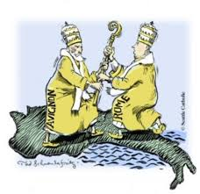
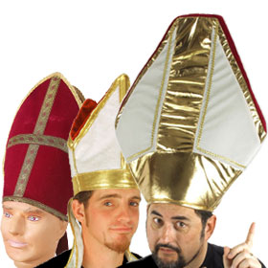
Great Schism & the “Babylonian Captivity”
RCC Internal Issues:
Secularization & visible corruption, bureaucracy
Benefice System + Annates + Rota Romana + Clericos Laicos + Theology Δs (Indulgences + Purgatory) = ↑ papal power
Boniface VIII > Unam Sanctum (papal bull) = Church Over State
RCC External Pressures:
Black Death = no answers
Rising Monarchs, France seeks more power, Germans seek more freedom
Great Schism: Pope Clement V (F) > Avignon (1309), Italy ☹ > 2 popes
Conciliar Movement > Pisa = 3 Popes > Constance = 1 Pope (1417)
Result? ↓RCC power, political & theological challenges…

Slide 11
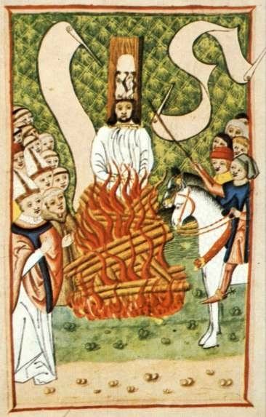
Challenges to RCC…
Marcilius of Padua: Defender of the Peace = RCC spiritual role ONLY
Lay Religious Movements:
Mysticism of Meister Eckhart > Modern Devotion (one w/ GOD) Bros. of Common Life (and Sisters)… Erasmus
Thomas Aquinas v. William Ockham: Role of reason v. faith?
John Huss & Hussites: Vernacular v. Latin, Eucharist issues = Heretic!
John Wycliffe & Lollards: Vernacular v. Latin, Challenge RCC Authority
Results = ↓ RCC power, seeds of Reformation

Slide 12
14th c. Cultural Developments…
Transition to the Renaissance, why?
Literature & Entertainment:
Dante, Petrarch, Chaucer, Boccaccio, de Pizan: Title & concept?
Holiday feasts, music, games… interactive
Art: Giotto = art imitates nature, realism
Women & Family: Nuclear Family, Gender roles, Child centered
Medicine: Shift from Galen’s “Four Humors” > “practice & learning”
Hierarchy (Physician, Surgeon, Midwife + Barber… Apothecary)
Technology: Mechanical clock, Optics, Paper, Gunpowder, Cannon
Urbanization: ↑Gov’t regulation (sanitation), ↑hedonism
What about prostitution?

Slide 13
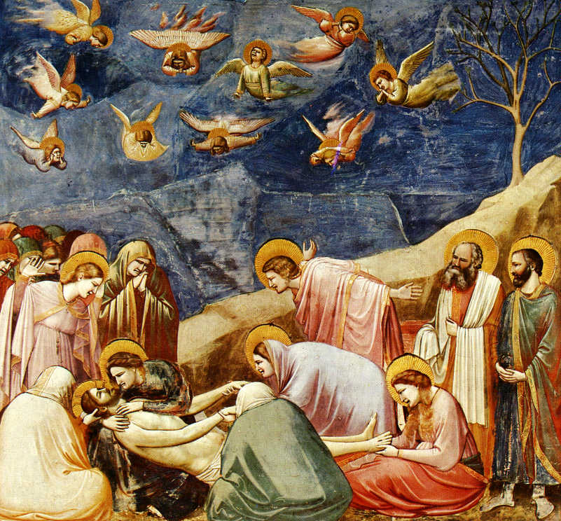
Giotto’s “Lamentation of the Christ” What is a Frescoe?

Slide 14
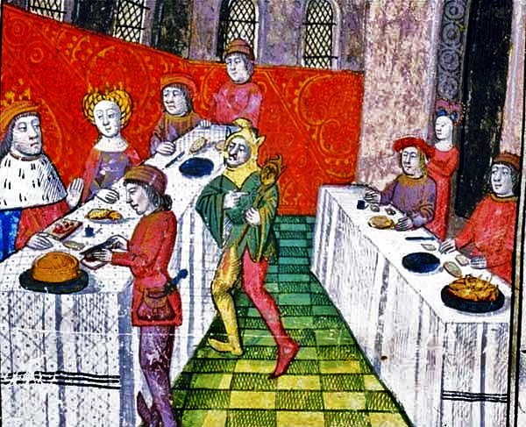
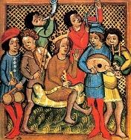
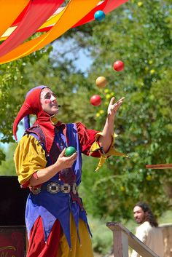
LM Ages Entertainment:

Slide 15
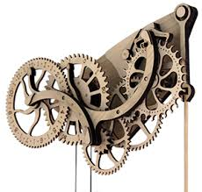
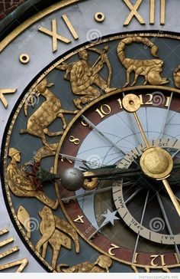
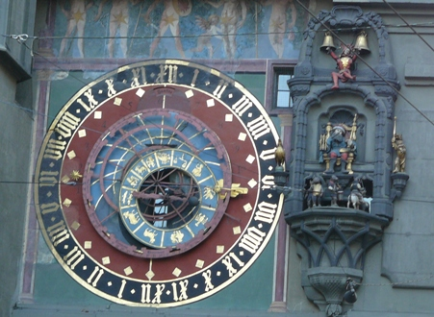
Mechanical Clock

