Slide 1
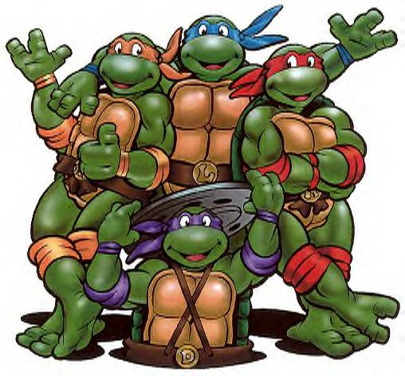
The Renaissance: Becoming Modern?

Slide 2
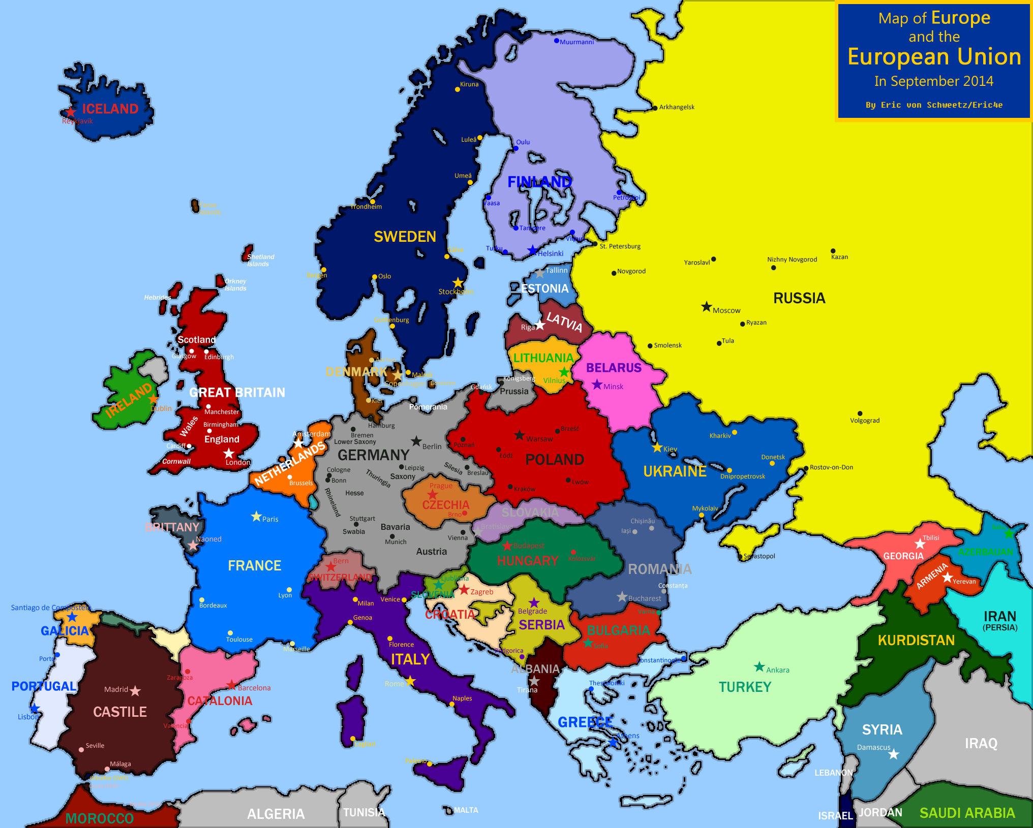
Modern Europe? What’s wrong?

Slide 3
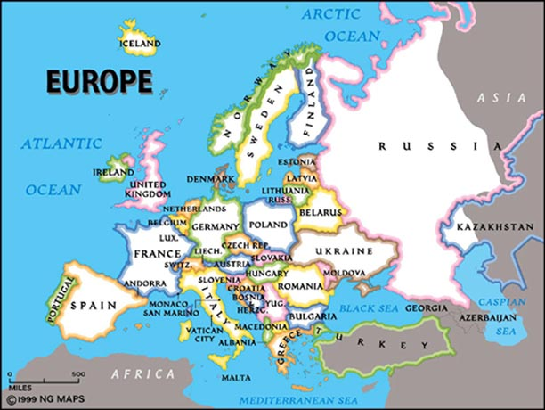
Modern Europe’s Borders

Slide 4
What does “Modern” mean?
Modern
Social?
Political?
Religious?
Intellectual?
Technology?
Economic?

Slide 5
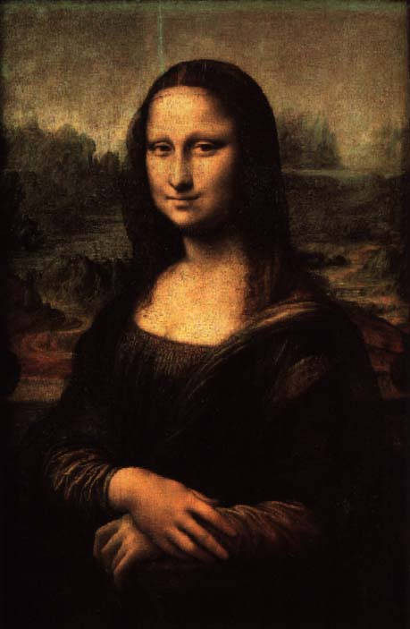
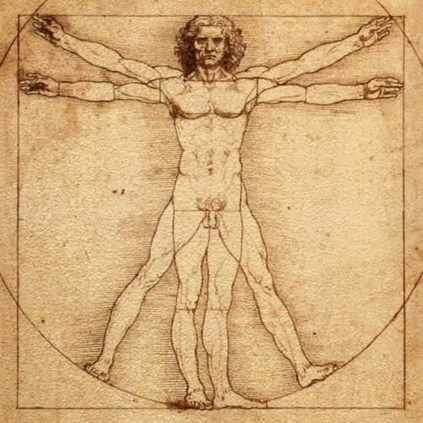
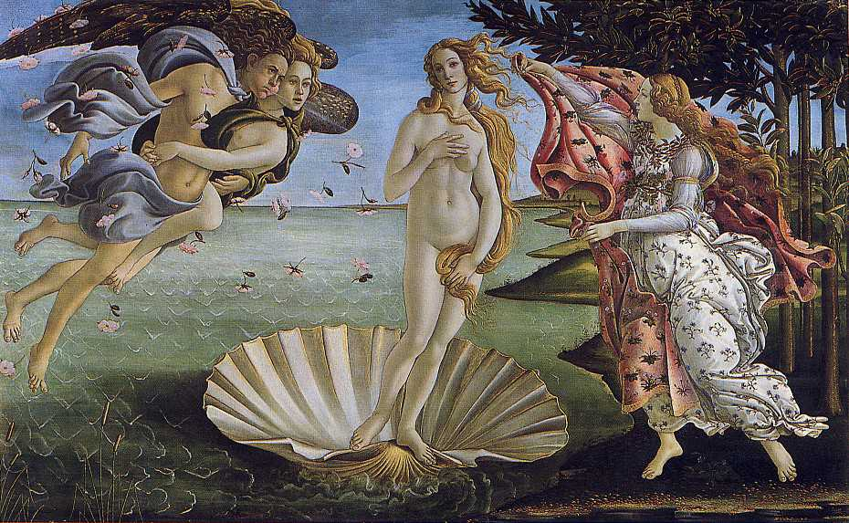
The Renaissance…
= Rebirth…
Of European knowledge, learning, culture, & science
Is it a transition to modern times or the beginning of modernity?

Slide 6
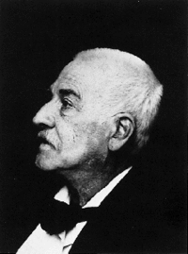
Jacob Burckhardt: Historian Civilization of the Renaissance 1860
Claimed 14th & 15th c. revival of Classical (ancient) learning in Italy led directly to new secular and scientific values.
Historians since have argued that there was more continuity between the Middle Ages & the Renaissance.
So What? Multiple POVs based on new evidence over time

Slide 7
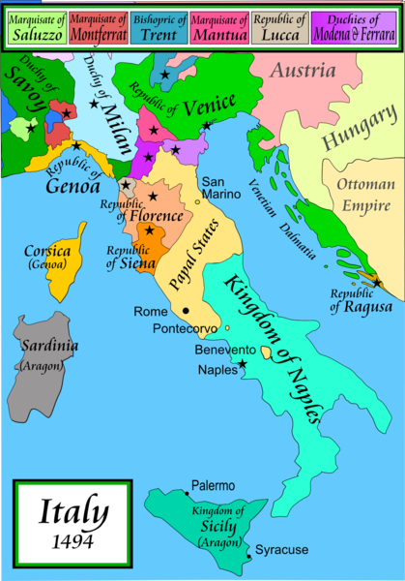
Italian City-States
↑↑ Papal v. State conflict >>
↑↑ independence for Italian C-S >>
↑↑ trade = ↑↑ $$,
Merchant class ↑↑ political power
Most powerful City-States:
Duchy of Milan
Republic of Florence
Republic of Venice
Papal States (Pope Rules in Rome)
Kingdom of Naples
Why Them?

Slide 8
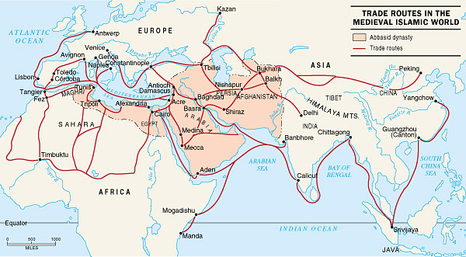
Think: Where do Italian C-S fit in the global picture of the 14-1500s CE?

Slide 9
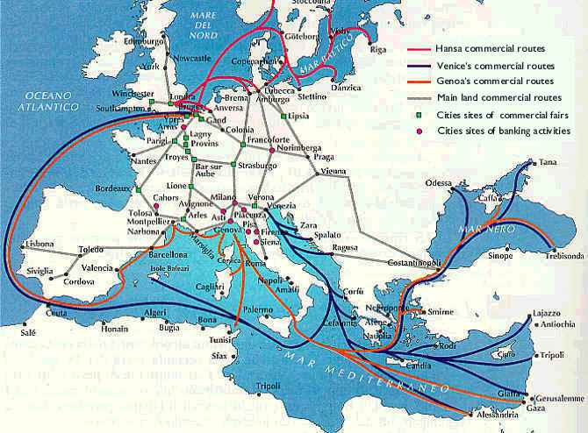
Why did Italian C-S grow?
Location, location, location
Europeans want…
-Silk, spices, perfumes
-Ivory, textiles, gold, copper…

Slide 10
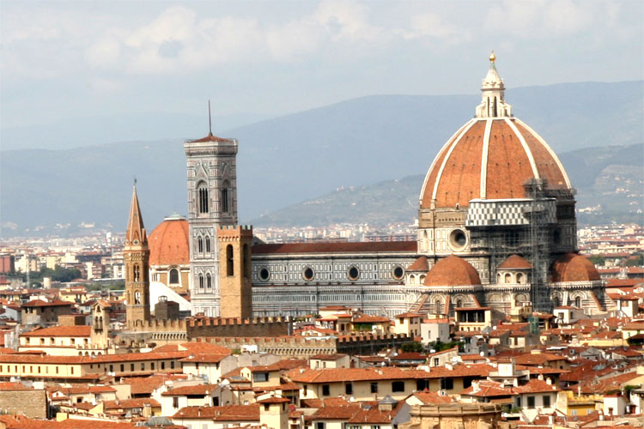
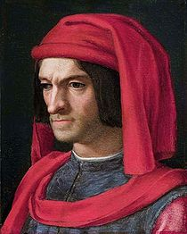
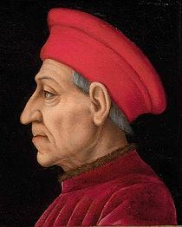
Renaissance Era Social Changes: Class and Despotism
Florence: Social Class Δs
Old Rich = grandi
New Rich Merchants = popolo grosso
Middle = shop owners, guild members, professionals
Poor = popolo minuto
Class Conflict
Ciompi Revolt (1378)
Despotism: Medici Style
Cosimo d’Medici, >> Lorenzo the Magnificent ruled Florence in totalitarian style.

Slide 11
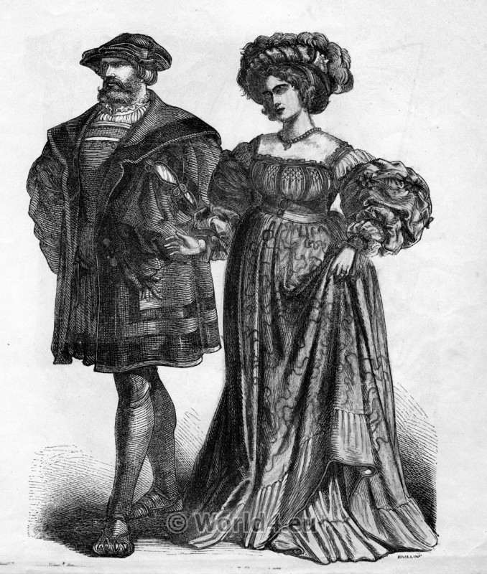
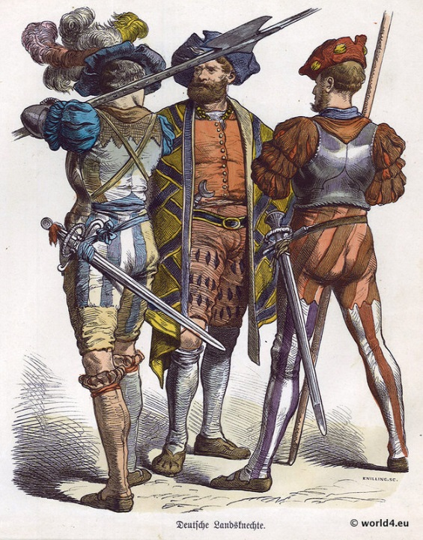
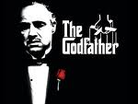
Italian City State Politics
Despots (“Podesta”) need support from
Merchants
Guild bosses
Clothing (silk, fur, wool) & Artisans
Employed mercenaries
Private army = order.
Mercenary brokers (“Condottieri”)
Despots demanded loyalty
Despots lived in fear
Safety
Assassination

Slide 12
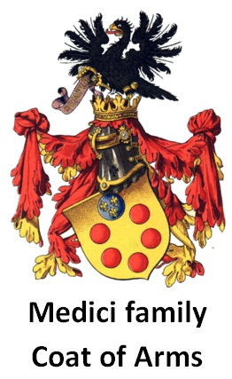
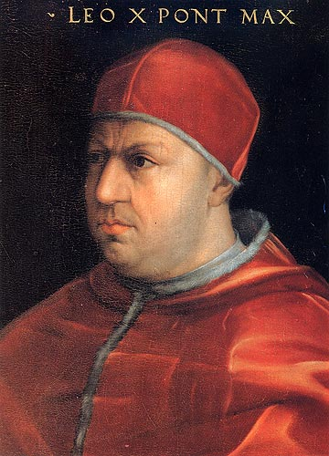
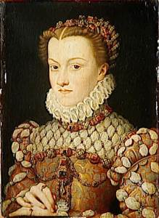
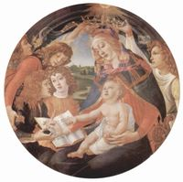
Medici Family
Ruled Florence
Bank was largest in Europe in the 15th C.
Medici Popes x 4 + 1 Queen
Sponsored great Art and Architecture in Florence
Machiavelli’s The Prince was directed to the Medici

Slide 13
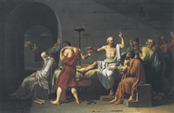
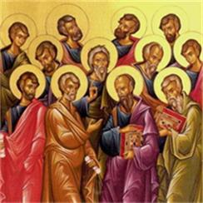
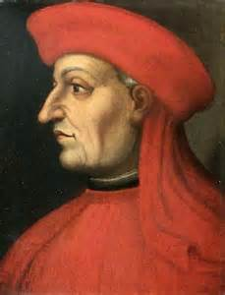
Humanism
Latin and Greek classics
Ancient Christianity.
Revive old norms & values
Studia Humanitatis:
Liberal Arts program: grammar, rhetoric, poetry, history, politics, moral philosophy
Most influential “rebirth”
Originator: Leonardo Bruni

Slide 14
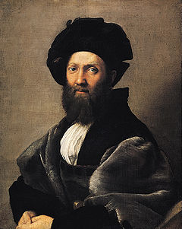
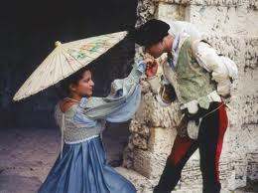
Baldassare Castiglione
The Book of the Courtier… early 1500s
A courtier is an advisor to a leader
What should an “ideal Renaissance gentleman” be like?
Middle Ages = a chivalrous knight.
Castiglione suggests...
Be Educated
Be multi-faceted
Be graceful!
How does this compare to the ideal Renaissance Lady?

Slide 15
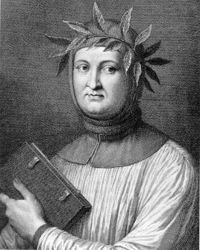
Petrarch 1304-74
Italian scholar, poet & Renaissance humanist.
“Father of Humanism,”
God gave humans intellectual & creative potential to be used to the fullest.
Famous love sonnets to “Laura” the idealized woman

Slide 16
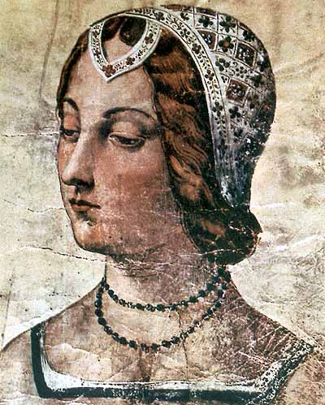
Petrarch wrote 365 sonnets to Laura
Overall theme: unattainable love
Sonnet 3
It was on that day when the sun’s ray was darkened in pity for its Maker, that I was captured, and did not defend myself, because your lovely eyes had bound me, Lady. It did not seem to me to be a time to guard myself against Love’s blows: so I went on confident, unsuspecting; from that, my troubles started, amongst the public sorrows. Love discovered me all weaponless, and opened the way to the heart through the eyes, which are made the passageways and doors of tears so that it seems to me it does him little honour to wound me with his arrow, in that state, he not showing his bow at all to you who are armed.

Slide 17
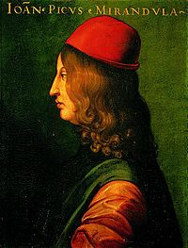
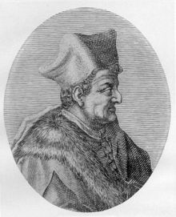
Pico della Mirandola
Author of Oration on the Dignity of Man
Justified the importance of the human quest for knowledge.
Lorenzo Valla
Scholar, Classical languages
Researched, critiqued, challenged & exposed false ideas via scholarship

Slide 18
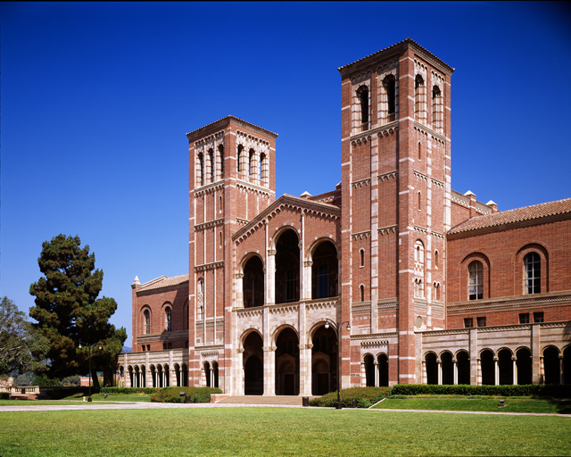
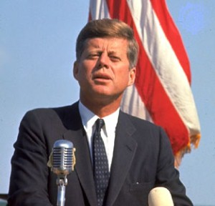
Civic Humanism
Humanists criticized education as useless.
Education should promote individual virtue and public service…Civic Humanism
Instead of being a scholar or a professor, serve your country
Remember the Greeks?
Plato = Philosopher Kings
Socrates = Duty to the Polis
Deep scholarship v. practical politics

