Slide 1
The European
Conquest
of the Globe
By: Ms. Susan M. Pojer Horace Greeley HS Chappaqua, NY
Edited & Adapted by R. Kolodinski - Glendale HS Glendale, CA

Slide 2
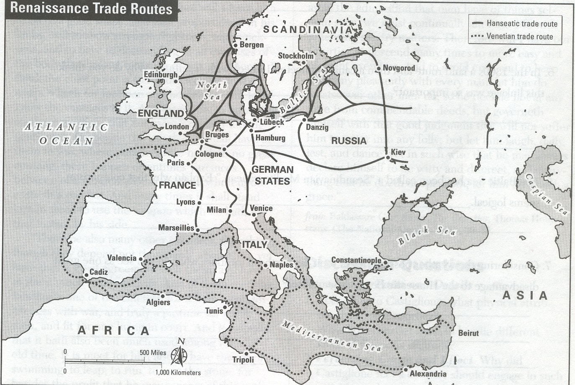
Renaissance Trade
Who controlled trade in Renaissance Europe?
Which cities appear to have key locations?
Which group controlled the Middle East, North Africa,& Spain?
Why was this considered a problem?
Ottoman Turks
Middle East

Slide 3
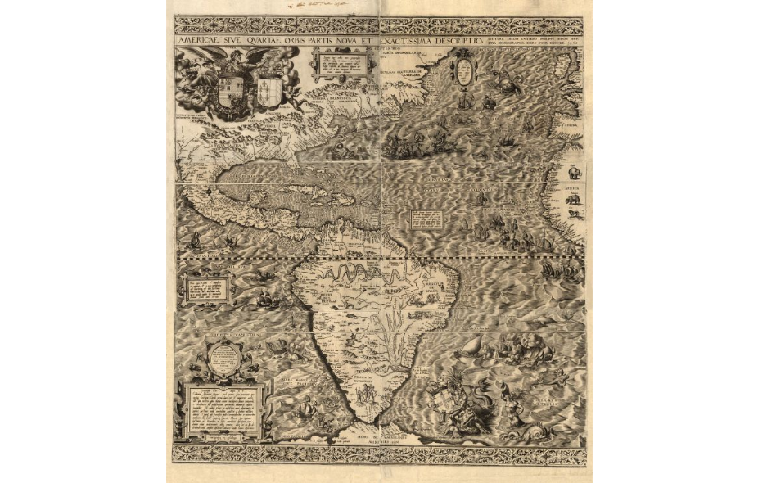
Americae sive quartae orbis partis nova et exactissima descriptio, Diego Gutierrez 1562
Analyze & list details
Categorize the details with a partner
What was is NOT included?
Hypothesize why Gutierrez included the specific details?
What is the purpose of the map?

Slide 4
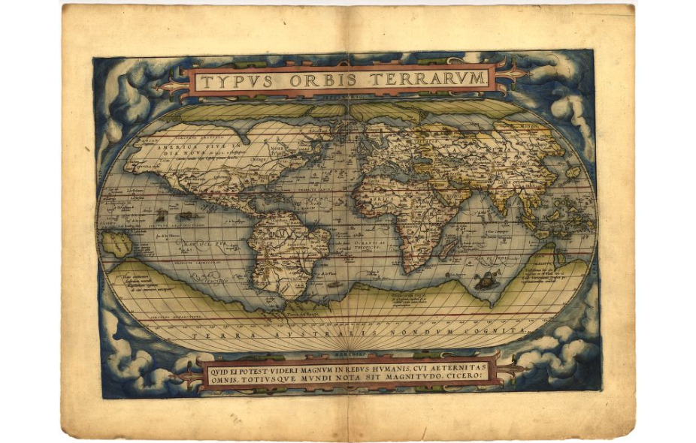
Theatrium orbis terrarum: Ornelias Atlas 1560s
Analyze & list details
Categorize the details with a partner
What was is NOT included?
Hypothesize why Ornelius included the specific details?
What is the purpose of the map?

Slide 5
Compare the Maps…

Slide 6
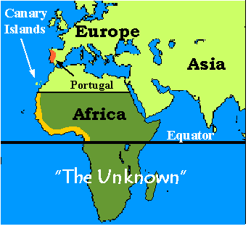
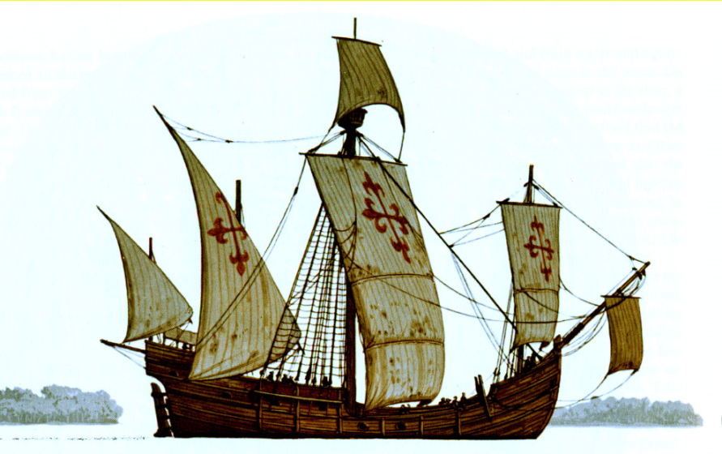
The Portuguese = 1st to go
Henry the Navigator
Portuguese expansion: Conquered Ceuta in North Africa, then Canary Islands, next ?
Navigation School >> caravel, cartography, astrolabe, compass…
Funds Explorations
Caravel = cargo!
Lateen Sails

Slide 7
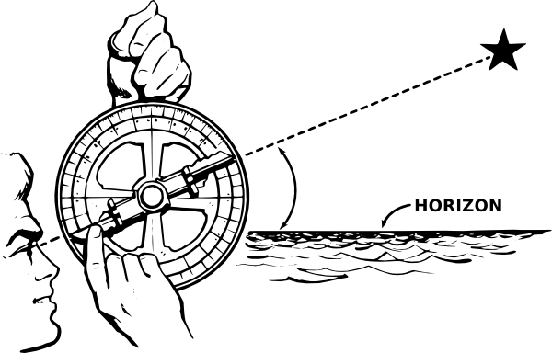
Where am I? Astrolabe & Latitude

Slide 8
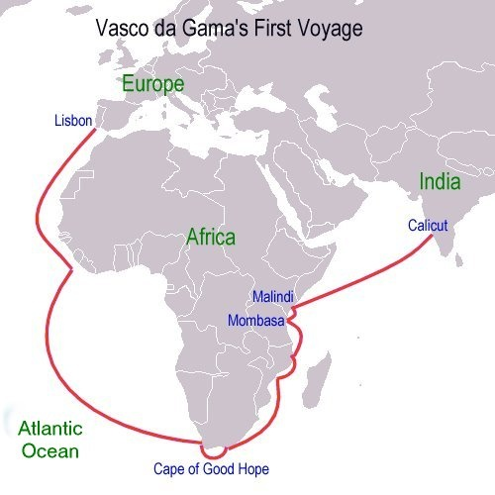
Portuguese Exploration
B. Dias to tip of Africa
Vasco de Gama goes on to India = $$?

Slide 9
Unification of Spain
Ferdinand of Aragon marries Isabella of Castile to create unified Spain.. Both RC
Drive out Muslim Moors & Jews 1492
Spanish Inquisition vs. “Heretics” to cleanse the country
How can Spain compete economically?

Slide 10
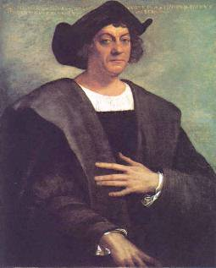
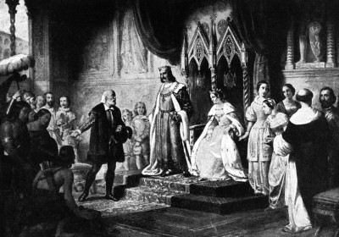
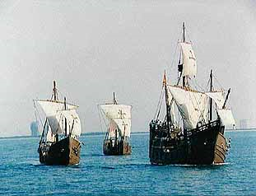
Christopher Columbus
Your Majesty, I can make you rich! Give me ships!

Slide 11
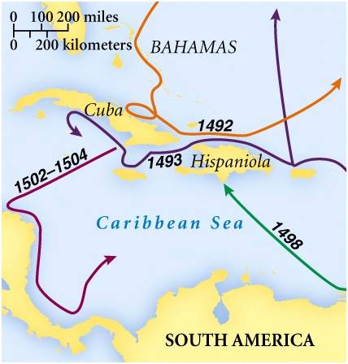
Columbus’ Four Voyages

Slide 12
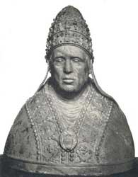
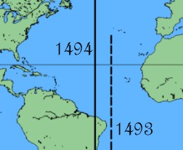
Treaty of Tordesillas, 1494
Spain vs. Portugal – Christian Economic Competition > War?
Pope Alexander VI
Mediates, declares…
1493 Demarcation Line
Portugal disputes, renegotiates
New 1494 treaty Line of Demarcation moved
Alexander VI denies, approved 1507 by Julius II
War Avoided… Impact?

Slide 13
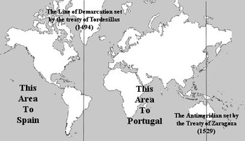
Treaty of Tordesillas 1493-94
Divides non-Christian New World between Spain (west) & Portugal (east)
What about the natives?
What about the other Europeans?
Short / Long Term Impact?

Slide 14
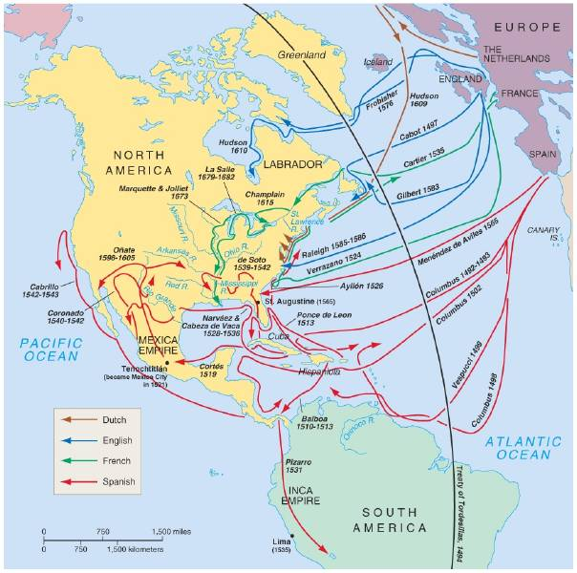
Other European Explorations
Why can’t we get over here?
On to China
Seeking “El Dorado” the city of gold and the legendary NW Passage to China

Slide 15
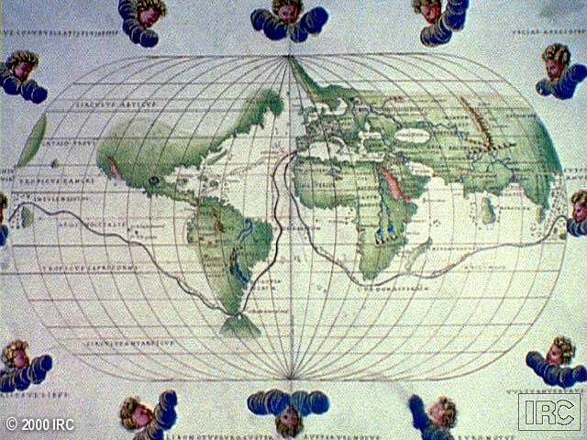
Ferdinand Magellan & the First Circumnavigation of the World (1519-22)

Slide 16
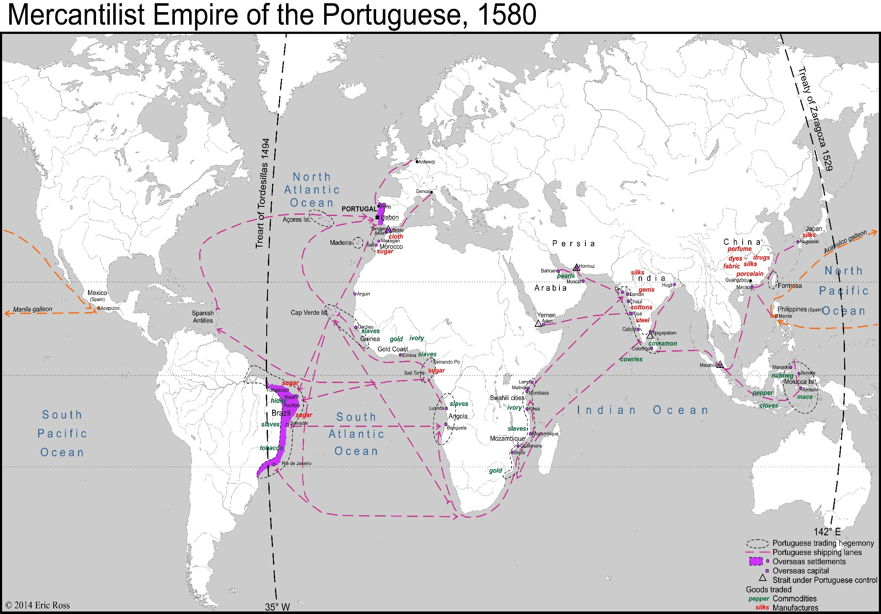

Slide 17
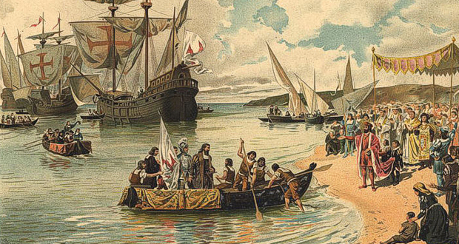
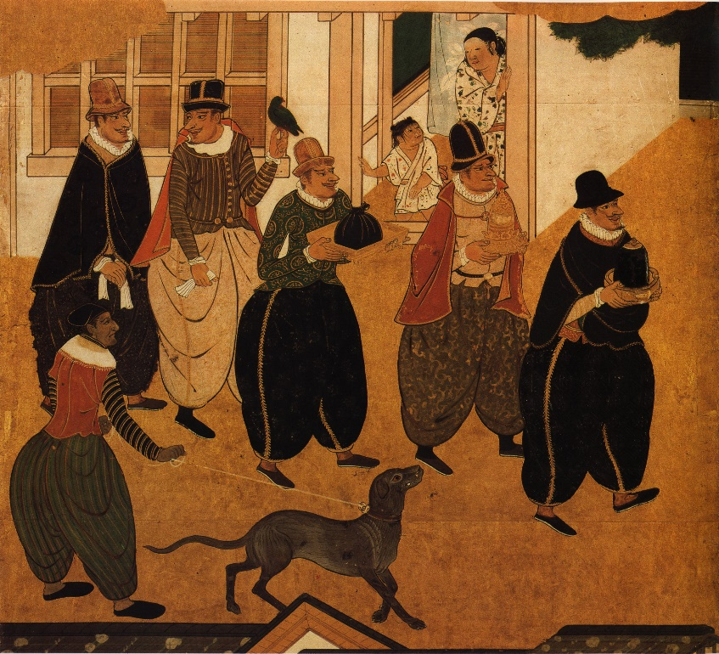
Portugal’s Maritime “Empire”
Began importing African slaves mid-1400s
1st Europeans to Africa & Asia
Supplant Arabs in Indian Ocean trade
Establish trading posts along coasts: West Africa, East Africa, India, Spice Islands, China, Japan
Lose Empire… why?

Slide 18
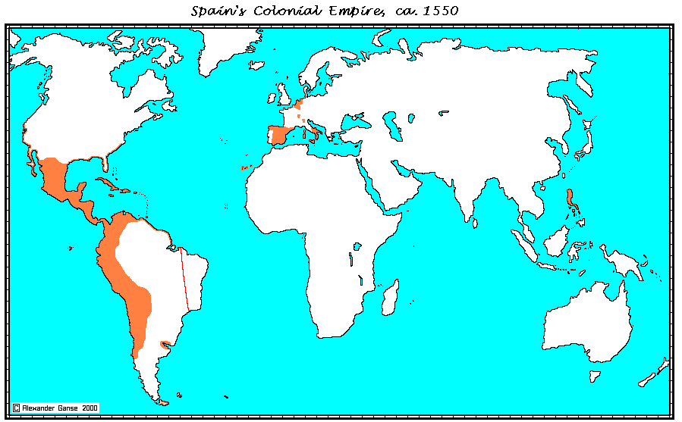
Spanish Netherlands
Naples & Sicily
Philippines
New World
How does this happen?

Slide 19
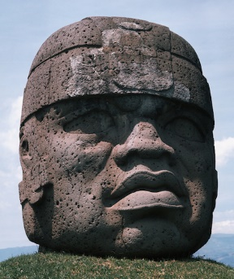
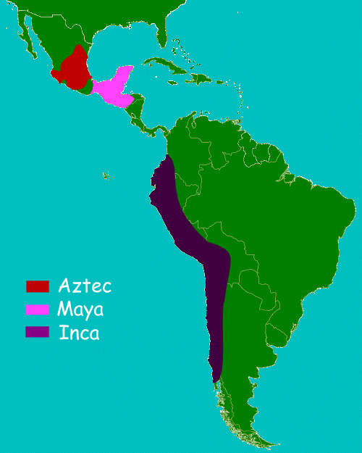
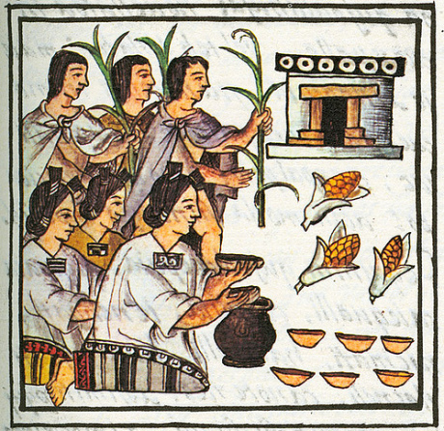
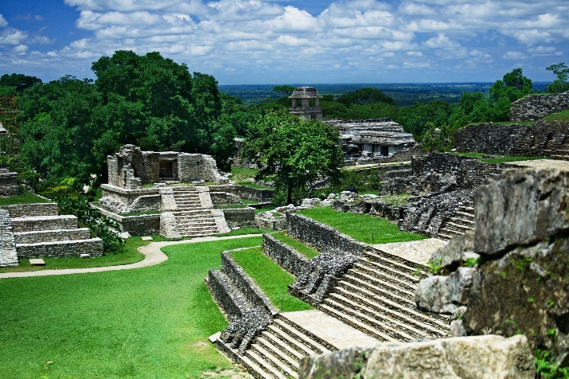
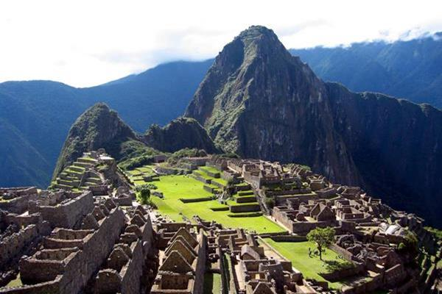
Pre-Columbian Mesoamerica
Olmec:
1200-400 BCE
Maya:
1800 BCE-900 CE
Aztec:
1100s -1525 CE
Inca:
1100s – 1572CE

Slide 20
Who were the “Conquistadors?”
Usually 2nd or younger sons, had nothing to lose…
Primogeniture laws gave family inheritance to eldest son…
Why not GO and make my own fortune?
They went for GOD, GOLD & GLORY… (the Three Gs)
Priests came too, no women or families… How does this impact development in Spanish America?

Slide 21
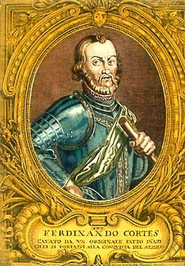
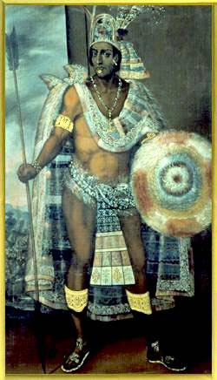
The First Spanish Conquests: The Aztecs
vs.
Hernando Cortes
Montezuma II

Slide 22
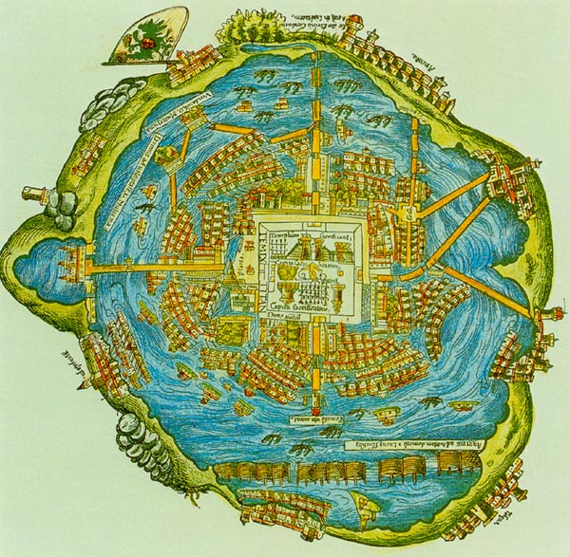
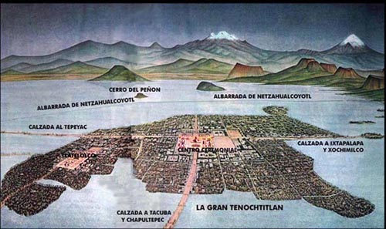
Tenochtitlan: Amazing!
Major metropolis
Bigger than any European city
Protected by water & causeways

Slide 23
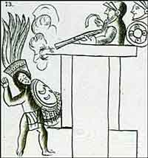
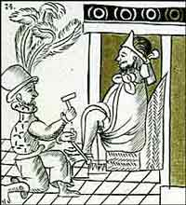
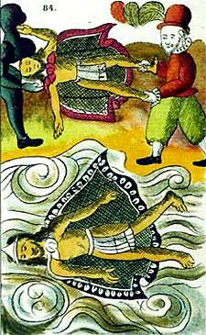
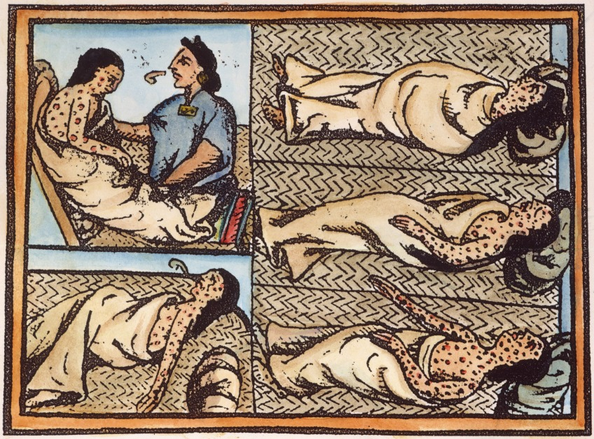
The Death of Montezuma II

Slide 24
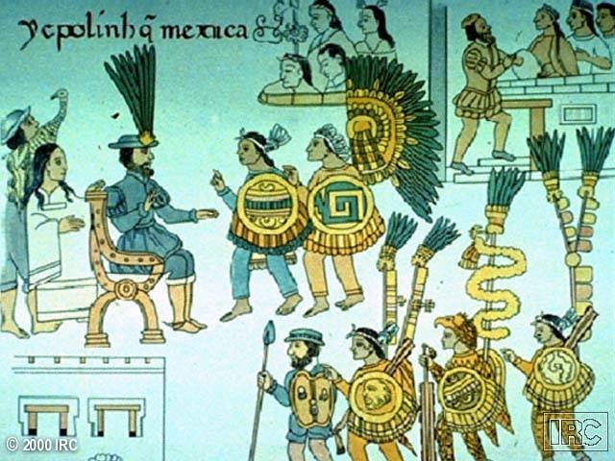
Mexico Surrenders to Cortes after Siege of Tenochtitlan

Slide 25
How can so few Spaniards conquer the Aztec Empire?
Cortes burns his ships on coast, failure is NOT an option! Keep rigging & equipment
Native girl Malinche translates through a marooned Spanish sailor / deserter
Cortes got co-operation from other groups under Aztec domination
Disease! Smallpox kills millions
Tech Advantage: armor, weapons, horses
Aztec prophecy lead to internal doubt

Slide 26
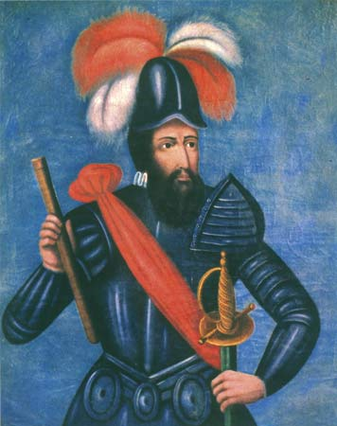
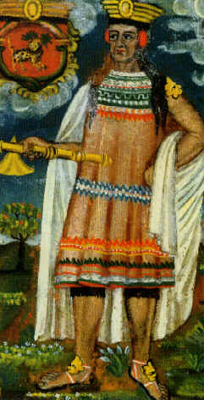
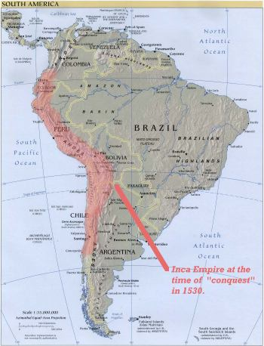
Spanish Conquest of The Incas
vs.
Francisco Pizarro
Atahualpa

Slide 27
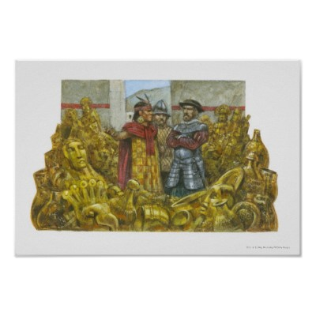
How does Pizarro conquer the Inca in Peru?
Weapons Advantage + disease help but…
Trickery… Captured leader & held for ransom… got the ransom, killed him anyway
Inca: no leader, no army, no problem for the Spanish

Slide 28
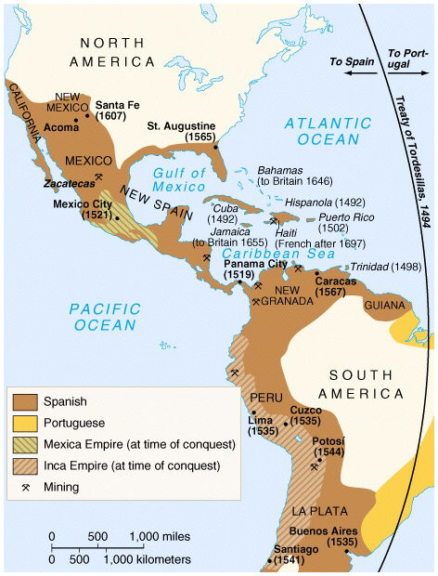
Spanish Empire
New Spain
New Granada
Peru
La Plata

Slide 29
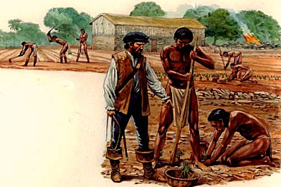
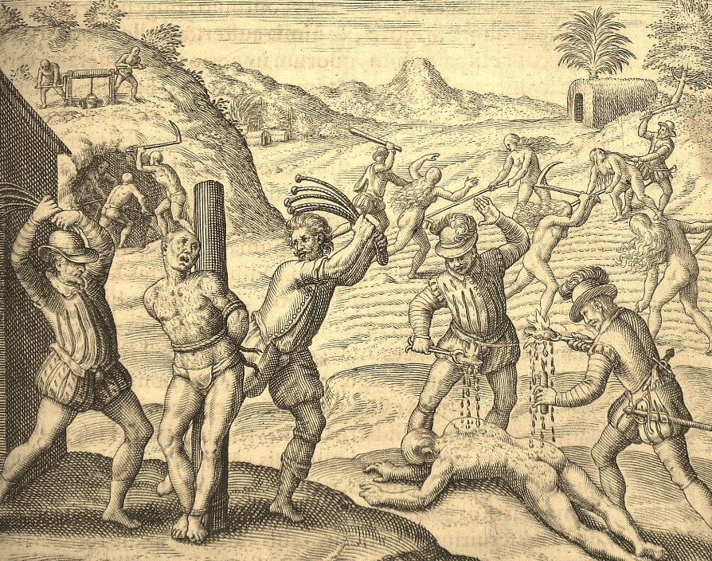
Encomienda System Established
Spanish Land Grants:
Ranching, Mining, Farming
Natives are “Peasant Labor”
Tied to land >> Peonage, Debt = Trapped!
Work to Death, Disease, Rebellion >>
Shrinking Work Force >

Slide 30
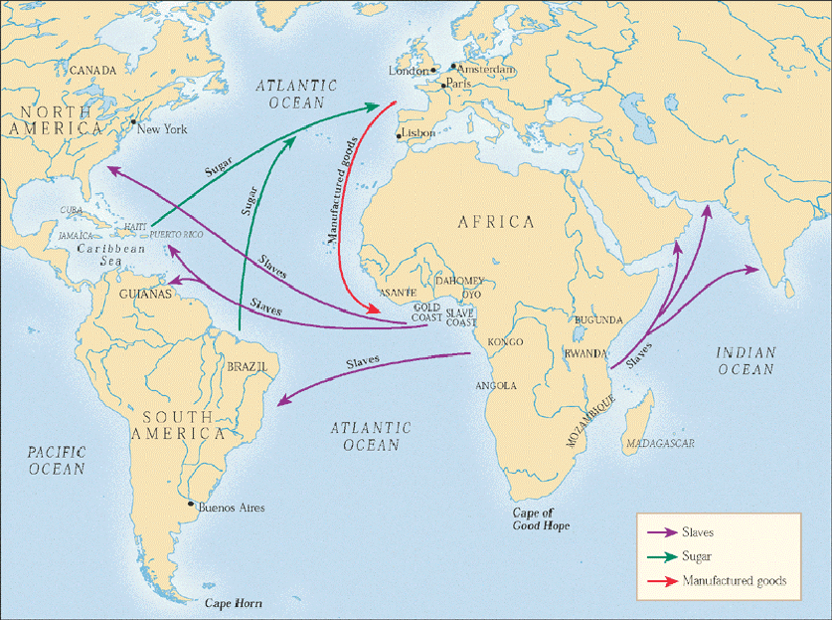
Trans-Atlantic Slave Trade
Middle Passage =
Africa > Americas

Slide 31
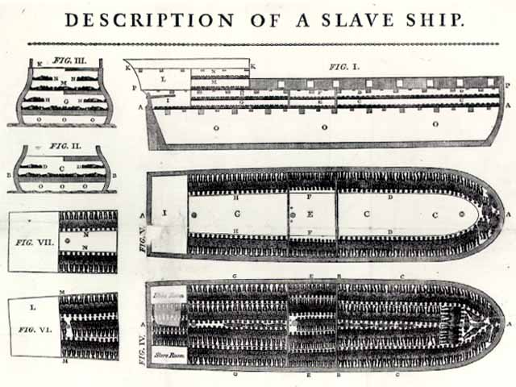
Slave Ship: More People = More $$

Slide 32
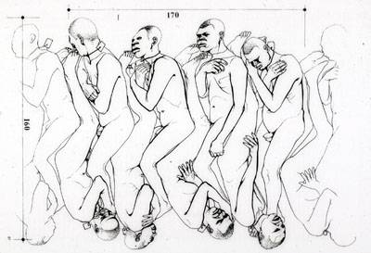
“Coffin” Position Below Deck During the Middle Passage

Slide 33
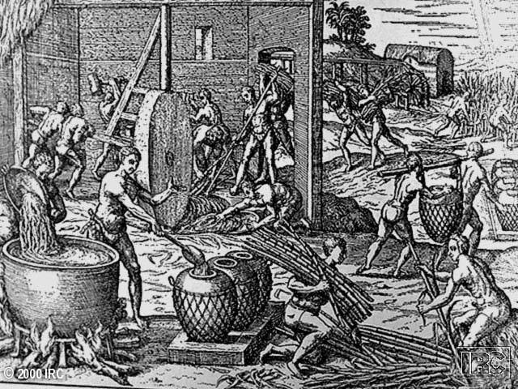
Slaves Working in a Brazilian Sugar Mill… LABOR INTENSIVE “Rich Man’s Crop”

Slide 34
Spanish Colonial Class System
Peninsulares
Creoles
Mestizos
Mulattos
Native Indians
Black Slaves

Slide 35
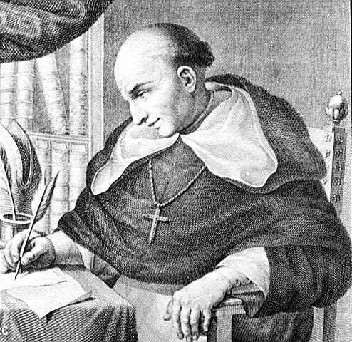
Father Bartolome de Las Casas Spoke up against the cruelty
Conquest unnecessary for Conversion
Exposed brutality
Black Legend emerges… Spanish “dark” side… leads to
New Laws 1500s

Slide 36
Cycle of Conquest & Colonization
New World
Territory
Conquest!
Explorers
Conquistadores
Missionaries
Official European Colony!
Permanent Settlers

Slide 37
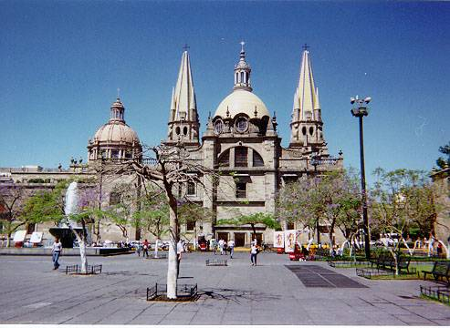
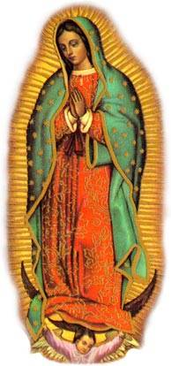
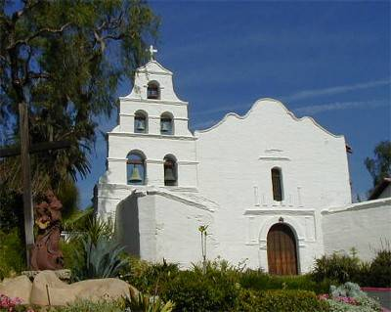
The Influence of the Colonial Catholic Church
Guadalajara Cathedral
Our Lady of Guadalupe
Spanish Mission
Spanish try to destroy native “pagan” practices & sites… build on top
Native peoples resist, blend Catholicism with traditions…

Slide 38
Why would the
'Columbian Exchange'
be considered the
tsunami of
unintentional
"bio-terrorism"??
Docs. 1- 4

Slide 39
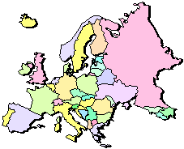
The “Columbian Exchange”
Squash | Avocado | Peppers | Sweet Potatoes
Turkey | Pumpkin | Tobacco | Quinine
Cocoa | Pineapple | Cassava | POTATO
Peanut | TOMATO | Vanilla | MAIZE
 | Syphilis
Trinkets
Liquor
GUNS
Olive | COFFEE BEAN | Banana | Rice
Onion | Turnip | Honeybee | Barley
Grape | Peach | SUGAR CANE | Oats
Citrus Fruits | Pear | Wheat | HORSE
Cattle | Sheep | Pigs | Smallpox
Flu | Typhus | Measles | Malaria
Diphtheria | Whooping Cough

Slide 40
Mercantilism
The economy & trade are essential to the health & safety of the nation.
Get as much gold and silver bullion as you can… assumes world has only a finite amount of wealth
Establish a favorable balance of trade… Exports > Imports
Get colonies = Supply & Market

Slide 41
Colonial Treasures from the Americas!

Slide 42
16th c. European Price Revolution
What caused “value” to ↓ & inflation to occur?
New World Foods
Population
Increase
Rising Food Demand & Prices
Marginal land used = ↑ Food Production Cost
+
Influx of New World Gold/Silver
Inflation!
16th c. Price Revolution is the rise in prices due to this process

Slide 43
European Empires in the Americas
Who is in the game by the 1600s?
Why did northern Europeans colonize exclusively in N. America?

Slide 44
Europeans in Asia: India

Slide 45
Europeans in Asia: India
Mughal Empire unites Hindu & Muslim kingdoms under Akbar
Portuguese, Dutch, English & French compete for trading rights
Portuguese squeezed out, Dutch focus on Spice Islands, English drive out French
Robert Clive > Battle of Plassey 1757
East India Company dominates (E)

Slide 46
Europeans in Asia: China & Japan

Slide 47
Europeans in Asia: China & Japan
Portuguese trade 1st > limited trading rights
China: Saw Europeans as inferiors
Ming > Qing (Manchu)...
China ↓↓ power, European power ↑↑
Limited trade and contact: Silk, Tea
Japan: Saw Europeans as “curiosities”
United under Tokugawa Shoguns
Limited trading rights, RC missionaries
RC expelled, Dutch can stay!

Slide 48
How did all this impact Europe?
Increased European “wants” drive “desire”
New Technology & discovery
First global superpower = Spain
Rivalries develop globally, subjugation!
Mercantilism >> Inflation, Job competition
Capitalism >> Joint Stock Companies > Middle Class grows
Globalization Phase 1:
Columbian Exchange & trade with Asia interconnect the globe

Slide 49
How did this impact those conquered?
New Social Hierarchy in Spanish America
RC Christianity adopted in Latin America
Joint Stock Companies dominate Asian trade, local businesses suffer
British East India Company (India)
Dutch East India Company (Indonesia)
Globalization Phase 1: Columbian Exchange area peoples become the cheap labor for Europeans

