Slide 1
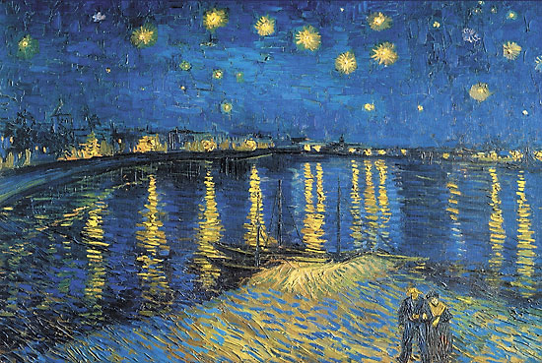
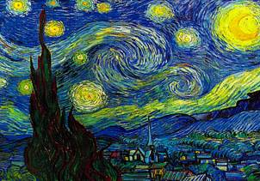
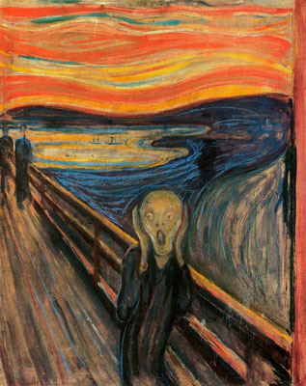
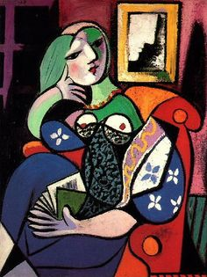
The Art of La Belle Epoch Late 19th – Early 20th c.
Impressionism, Post-Impressionism, Expressionism, Cubism
Monet, Cezanne, Degas, Van Gogh, Matisse, Picasso and Others

Slide 2
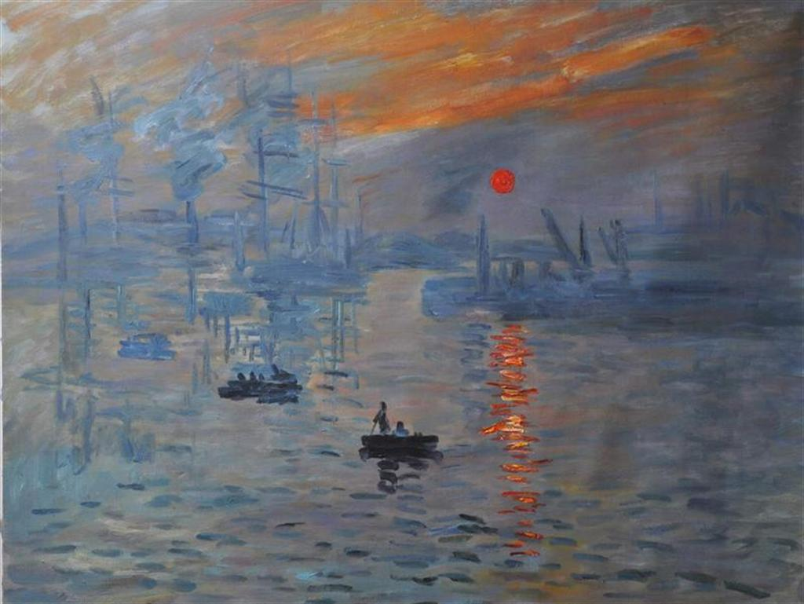
Impressionism
Reaction vs. Romantic emotionalism
More detached, objective
At a glance, often blurred
Landscapes, Still-Lifes, Snapshots
ClaudeMonet, Sunrise

Slide 3
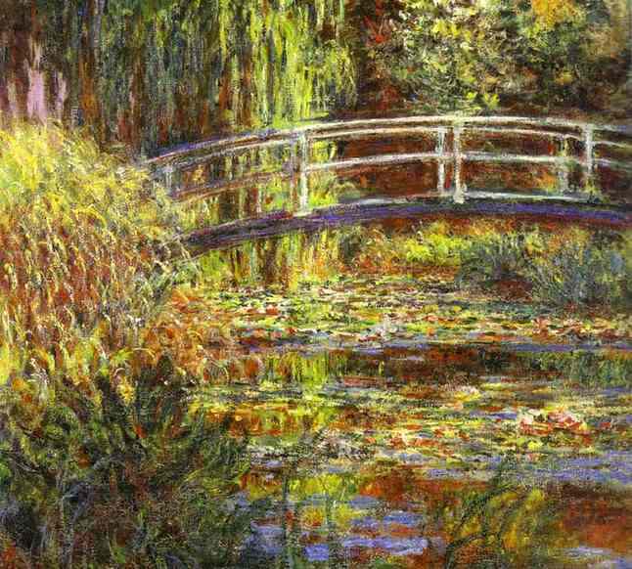
Impressionism: Claude Monet Japanese Bridge

Slide 4
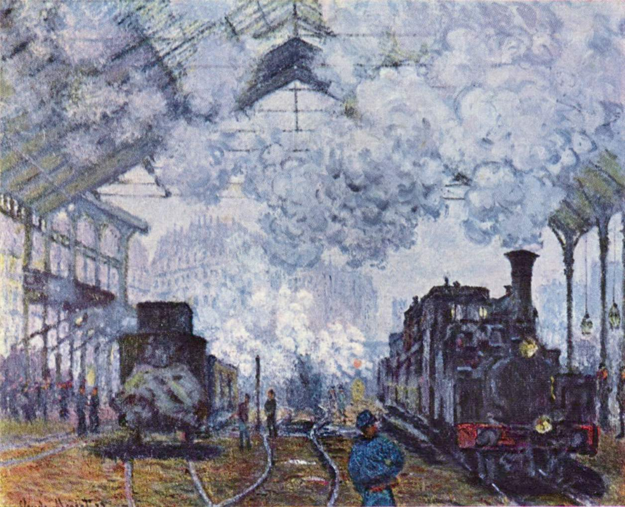
Monet: Gare Saint Lazare

Slide 5
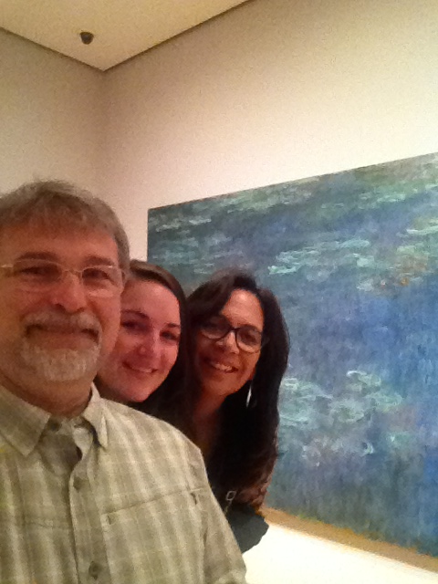
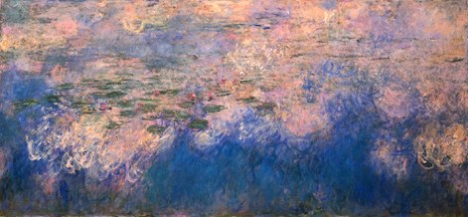
Me at MOMA, NYC & Monet’s Water Lilies

Slide 6
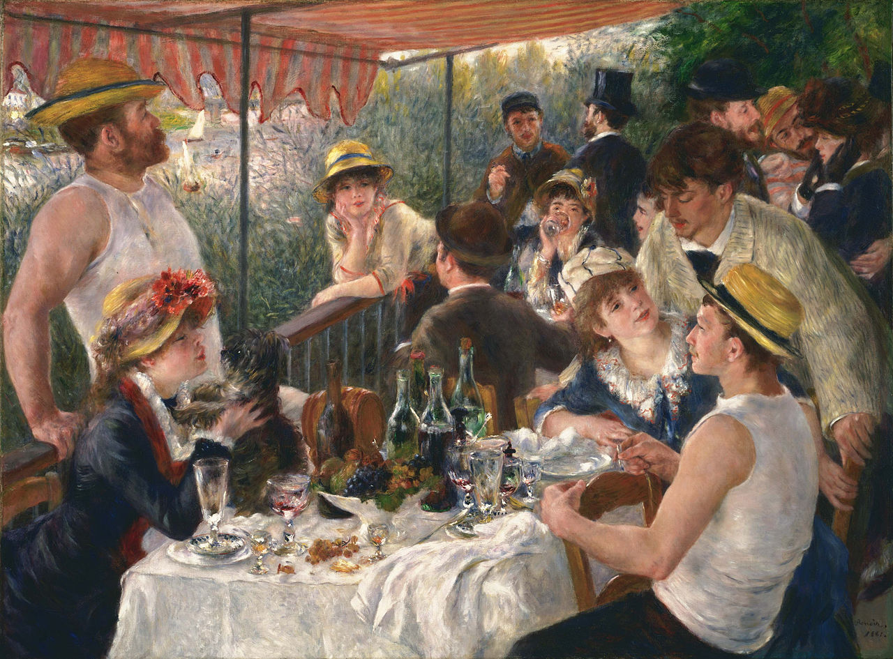
Pierre Auguste Renoir: The Luncheon of the Boating Party

Slide 7
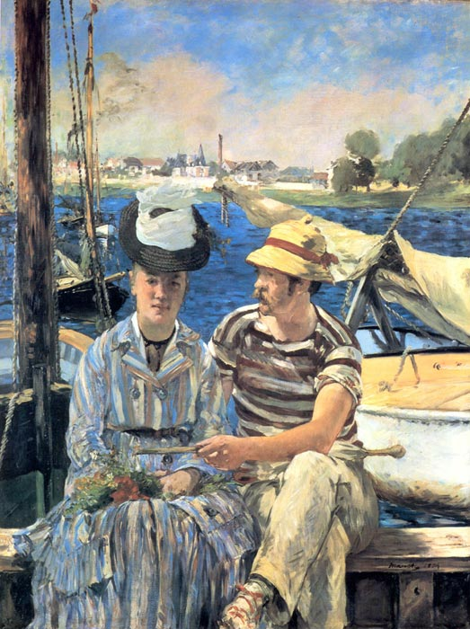
Eduard Manet: Argenteuil -Action, Balance

Slide 8
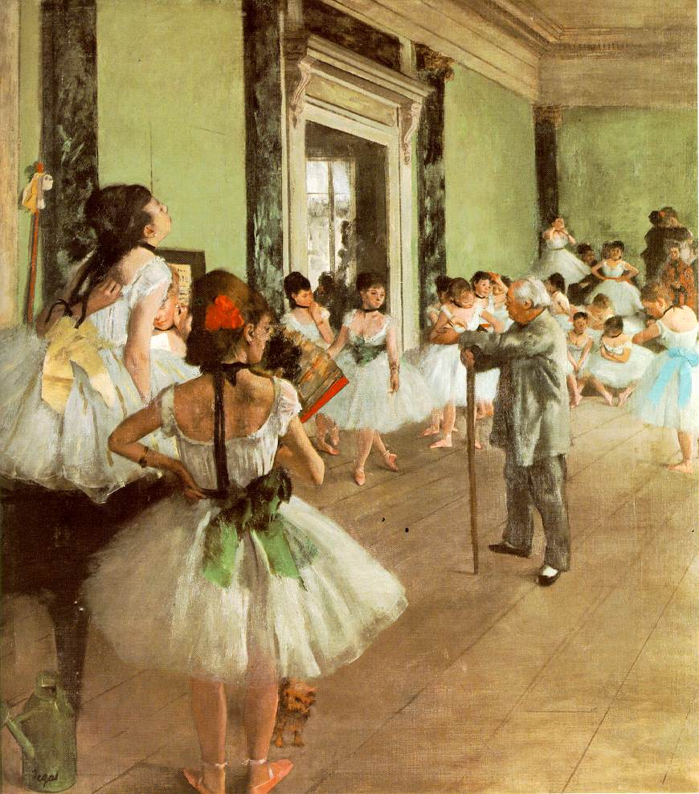
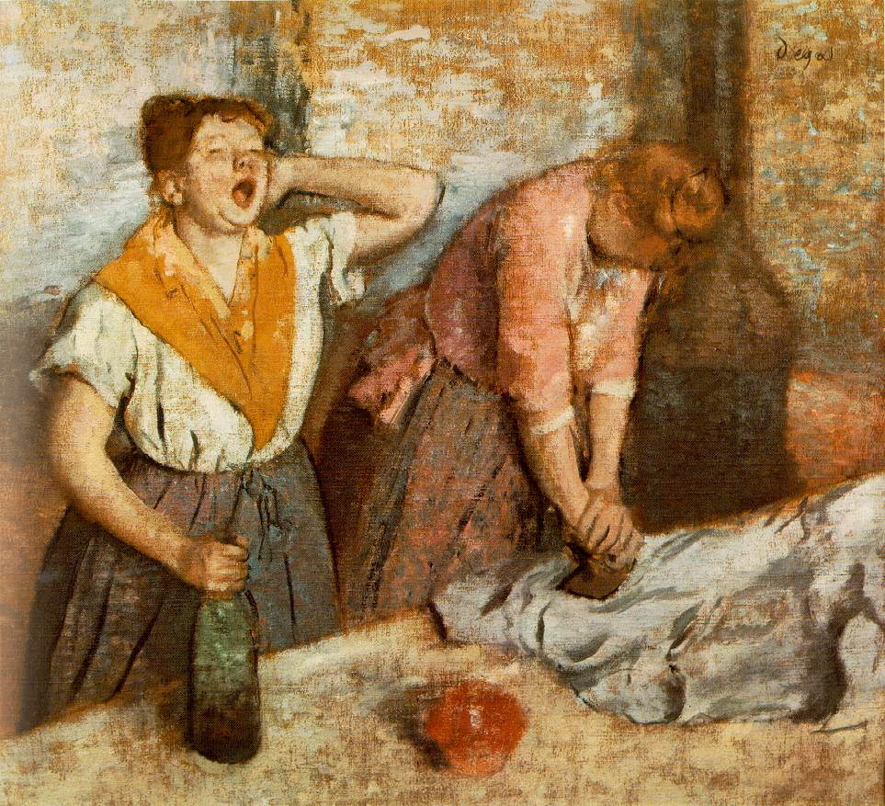
Impressionism: Edgar Degas Everyday Life

Slide 9
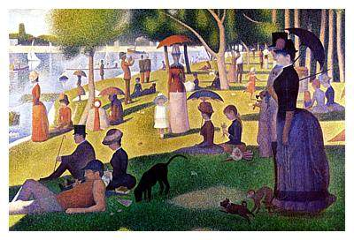
Post-Impressionism
Reaction vs. Impressionist “moment in time” style
Create art with more formal structure
Move towards greater abstraction
Pointillism:
Georges Seurat’s La Grande Jatte

Slide 10
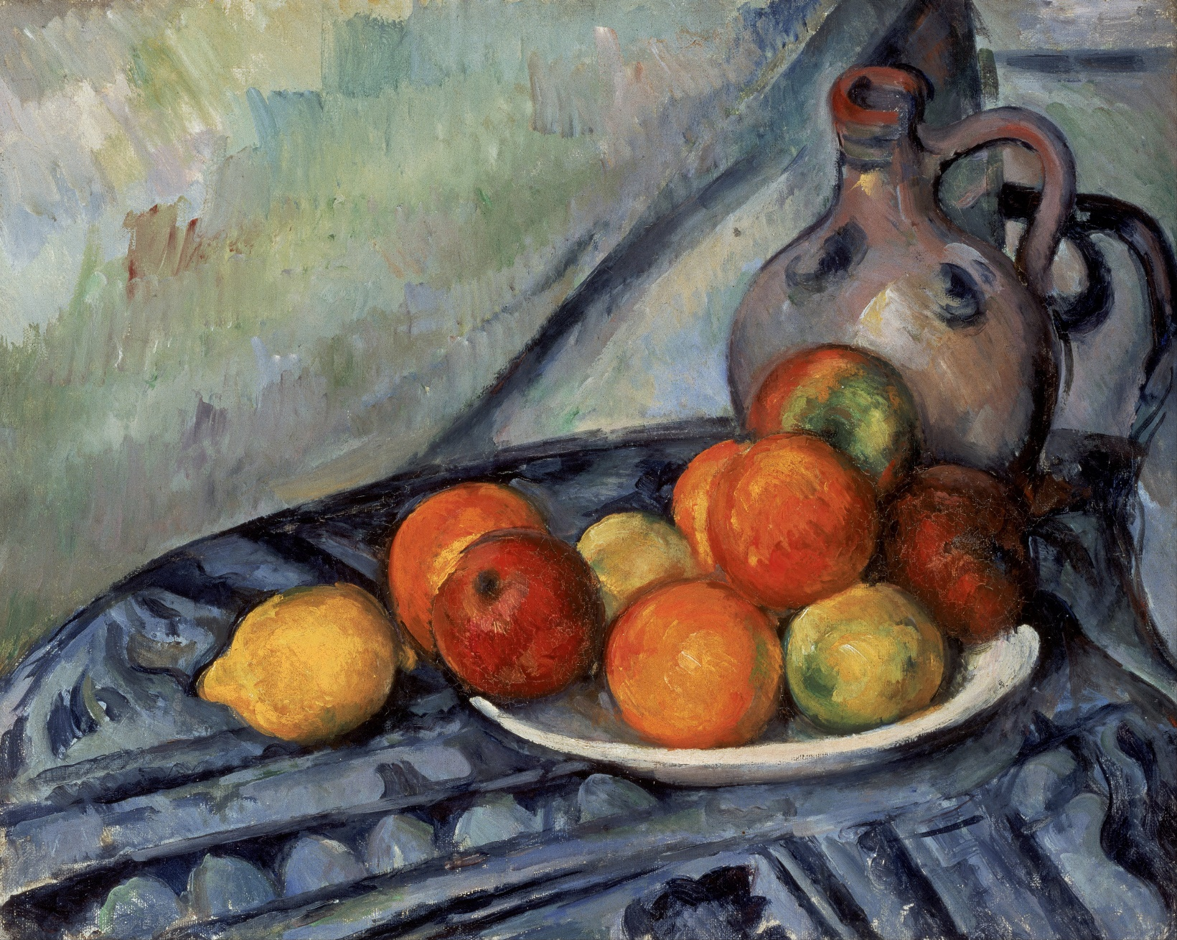
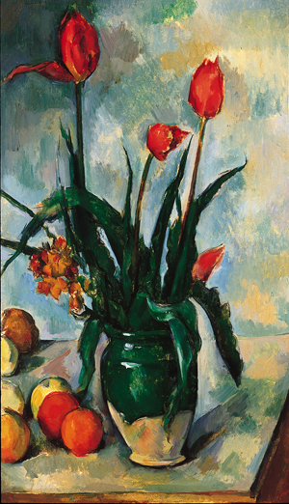
Post-Impressionism: Paul Cezanne

Slide 11
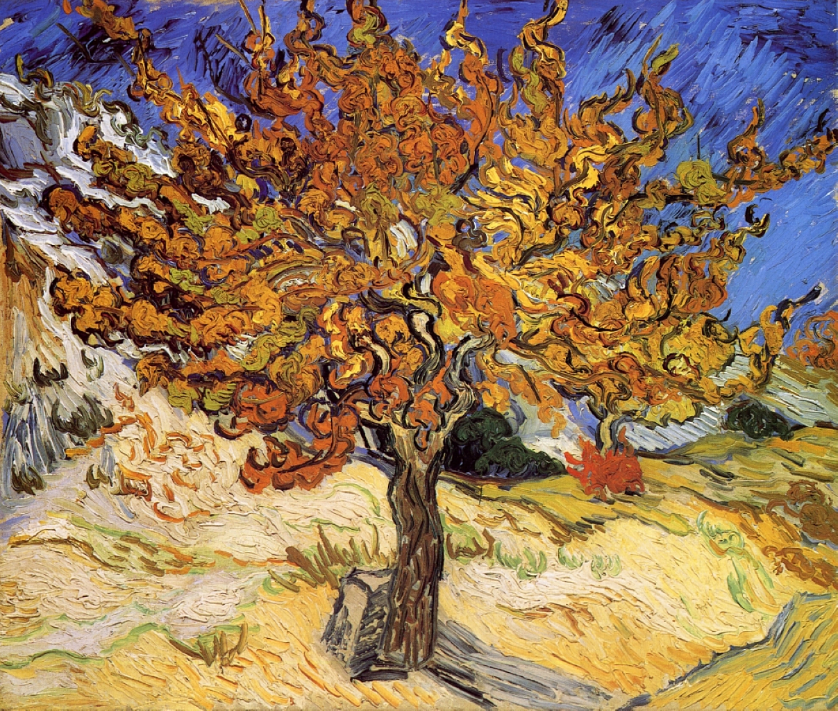
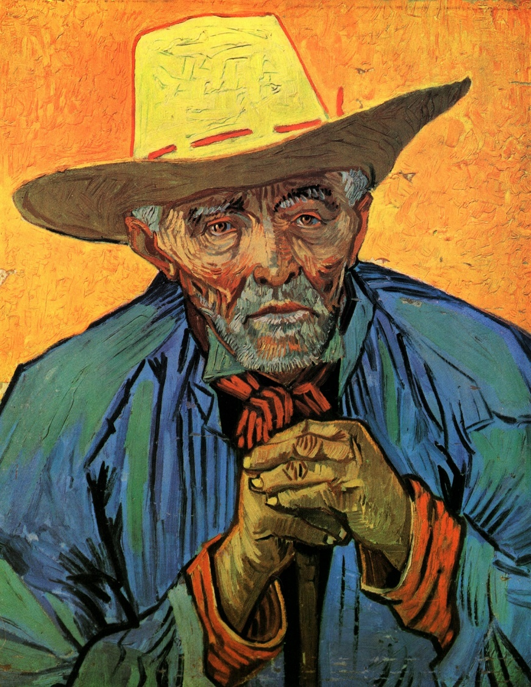
Post-Impressionism: Vincent Van Gogh

Slide 12
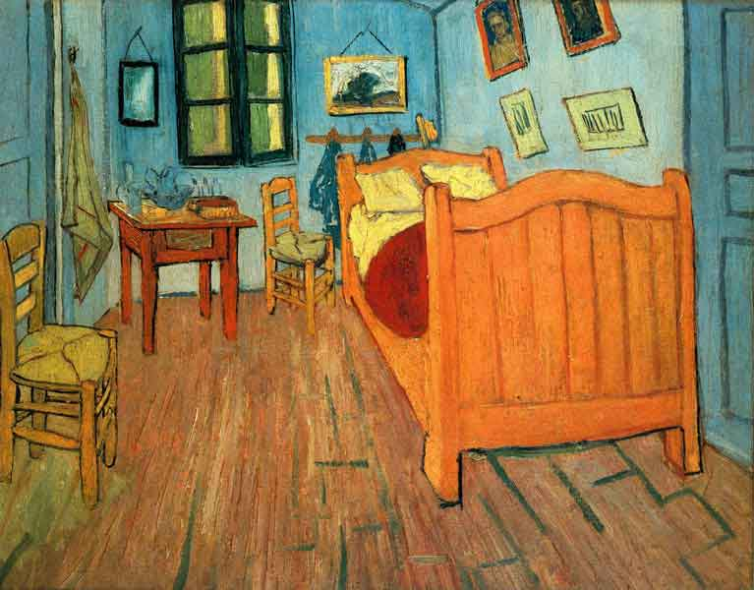
P-Imp… Van Gogh, again…

Slide 13
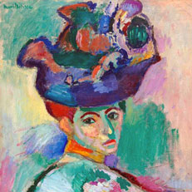
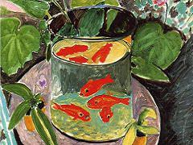
P-Imp / Fauvism: Henri Matisse

Slide 14
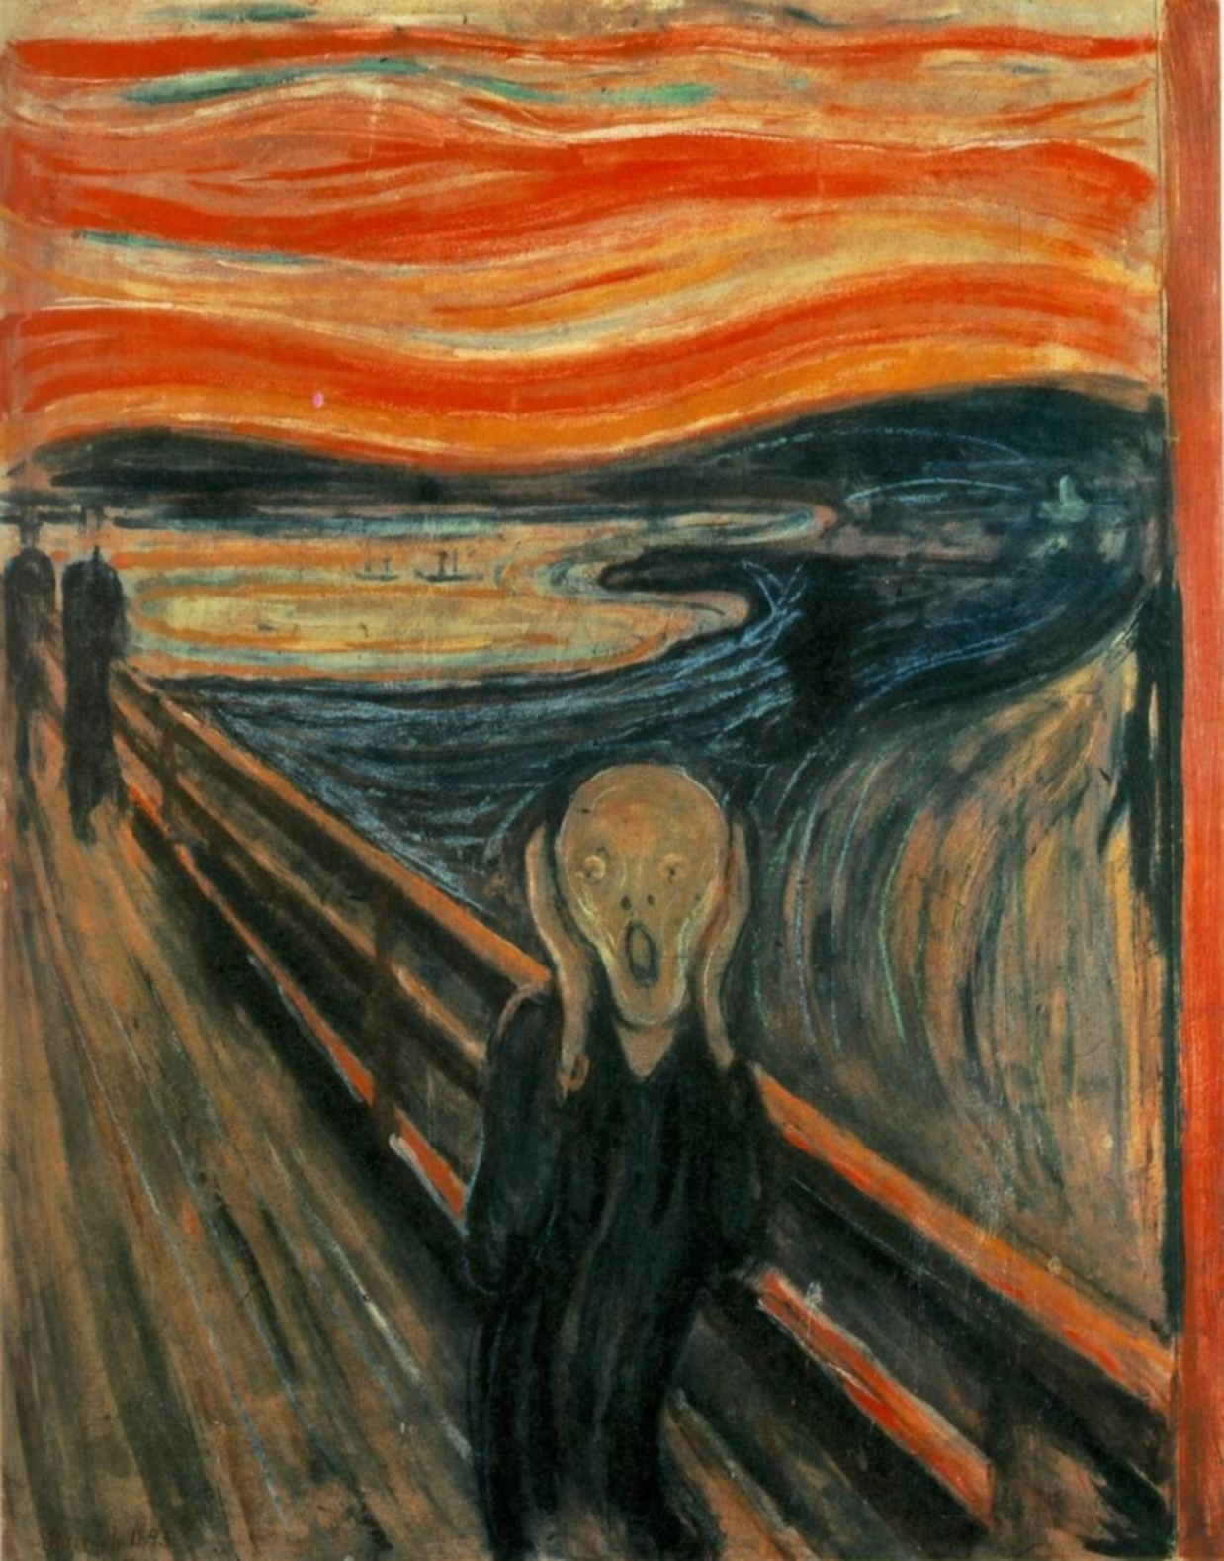
Expressionsim
Some overlap with Post-Impressionism
Exaggerated features
Bold, distortion, emphasis
Scream by Edvard Munch

Slide 15
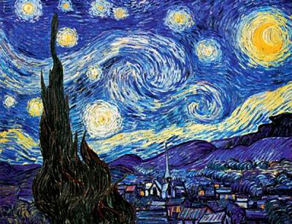
Expressionism: Van Gogh Starry Night

Slide 16
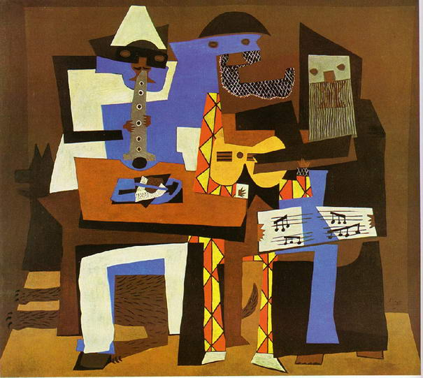
Cubism
New way to view the world, in line with new philosophies & innovations
Geometric & angular
Forms dissected and reassembled
Braque & Picasso
Three Musicians, Picasso

Slide 17
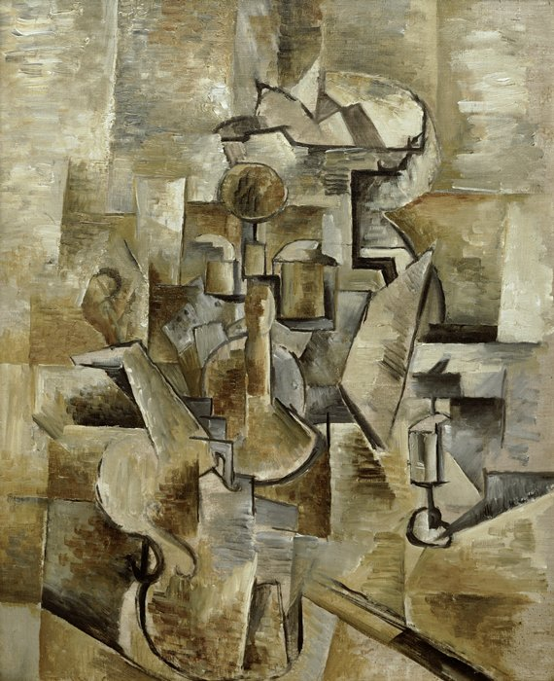
Cubism: Braque Violin & Candlestick

Slide 18
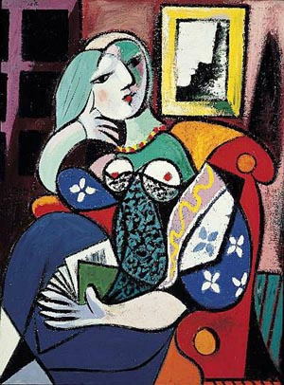
Picasso: Woman with Book

