Slide 1
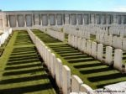
The First World War
Or
How a Teenager Can Change Everything

Slide 2
What were the 5 causes of WW1?
M
I
WW1
N
A
A

Slide 3
What were the 5 causes of WW I? How are these connected to 2nd Industrial Revolution?
MANIA…
Militarism = pro-war attitude > arms race
Alliances
Triple Alliance
Triple Entente
Nationalism = pride to the extreme > volatile
Imperialism = global competition to the max > crisis points
Plus…

Slide 4
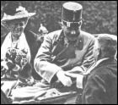
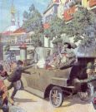
What Caused World War 1?
The Trigger Event…
Assassination of Archduke Franz Ferdinand of Austria-Hungary
Gavrilo Princip (19) was Serbian
Serbia supplied the weapons
Reactions?
The Chain of Foolish Demands
Austria-Hungary sends an ultimatum to Serbia…Serbia rejects one part
Austria-Hungary declares WAR on Serbia,
Alliances take effect… Russia mobilizes, Germany declares war on Russia AND France…

Slide 5
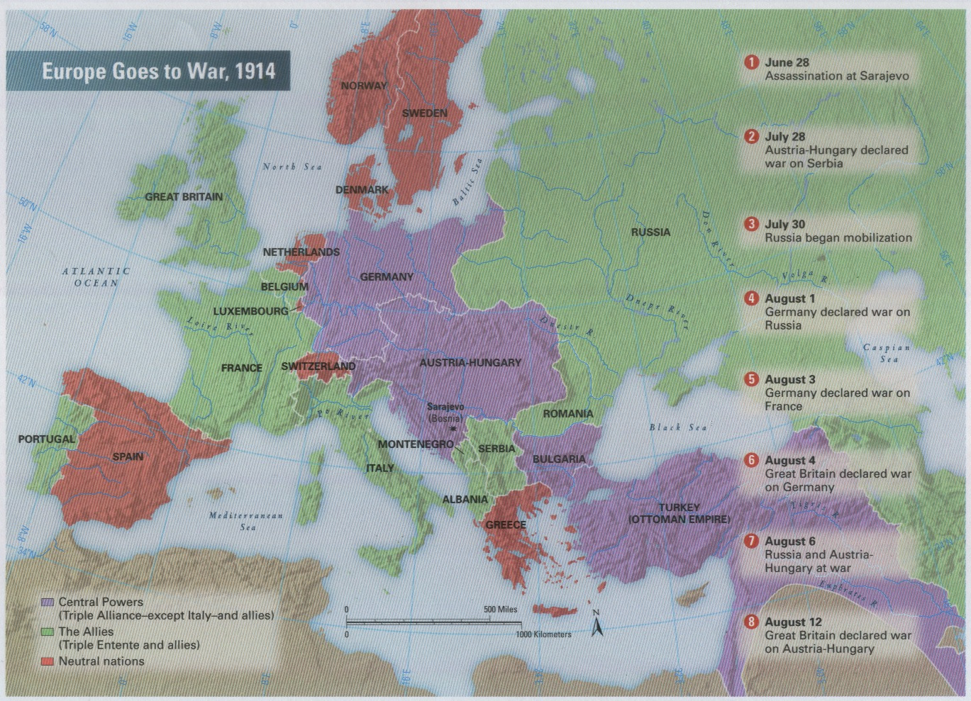
WW1 – The Beginnings
Allies vs. Central Powers …Let’s Get It On!

Slide 6
So, who is vs. who? Is it truly balanced?
Allied
?
?
Central
?
?
?
?

Slide 7
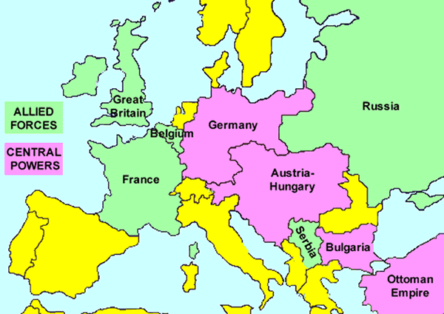
How will location & geography drive behavior?

Slide 8
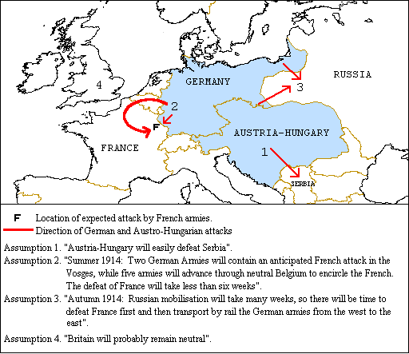
The German Schlieffen Plan
1st defeat France, then defeat Russia
Belgium resists demand for free passage… Germany attacks!
GB enters war to defend Belgium (1830)

Slide 9
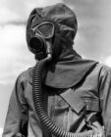
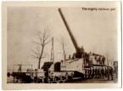
Industrialism: Deadly Technology
New style of uniforms
Dark, dull colors
New weapons
Machine gun
Tank & Artillery
Flame-thrower
Airplane & Submarine
Poison Gas
= Increased Death Toll

Slide 10
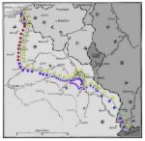
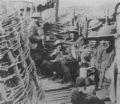
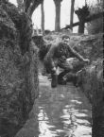
Western Front of WW1: The THREE Key Battles
1st Battle of Marne… Sept 1914
Stopped German advance in France
Stalemate >> Trench Warfare
Western Front = 400 miles of trenches
Battle of Verdun… Feb 1916… French hold!!
600k casualties
Battle of Somme… July – Nov 1916
1.2 million casualties

Slide 11
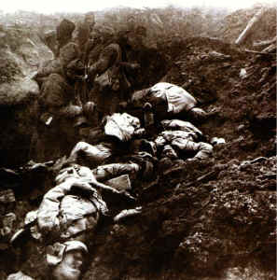
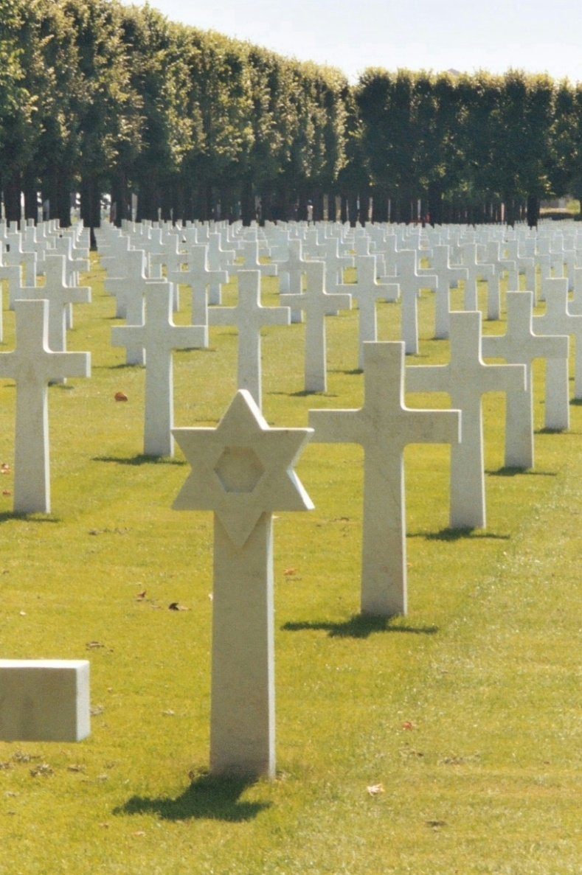
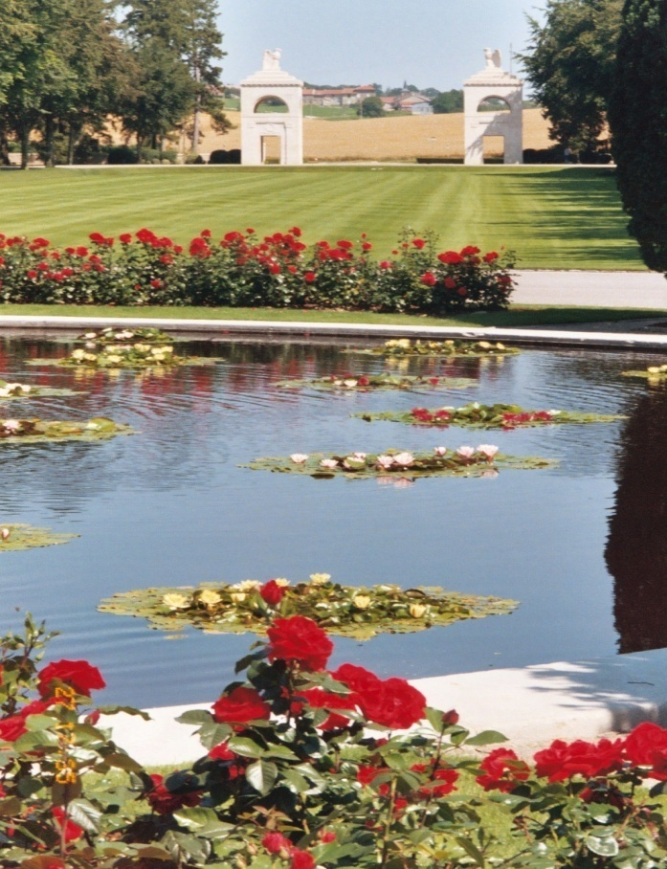
Verdun 1916 > Today

Slide 12
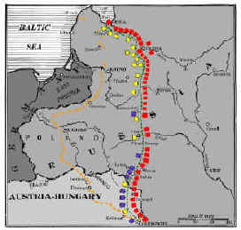
Eastern Front WW1: Key Battle & Reality
Russia & Serbia vs. Germany & A-H
“The Frozen Front”
Battle of Tannenberg
R suffers heavy losses, discontent grows
Russia in WW1
Poorly equipped
Under supplied due to enemy control of shipping lanes in Baltic & Black seas
Heaviest losses suffered

Slide 13
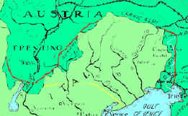
WW1: Italian Front = Promises!
Allies make a secret treaty with ‘neutral’ Italy
Promised Trieste, territory & colonies
Italy vs. Austria-Hungary… 1915
Diverts Austrian & German troops from major battle areas
Trieste = port!

Slide 14
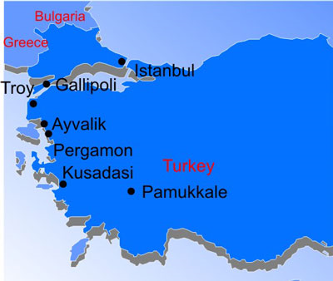
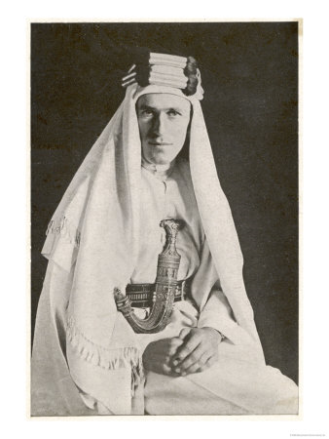
WW1: Key Middle East Battles
Gallipoli Campaign 1915
GB & colonies vs. Ottoman Empire
Attack the Dardanelles >> Constantinople
“Surprise attack” failed >> stalemate… ☹
Arabs & T. E. Lawrence
British use Col T. E. Lawrence & Arab tribes to disrupt Ottoman Empire… Guerilla Warfare!

Slide 15
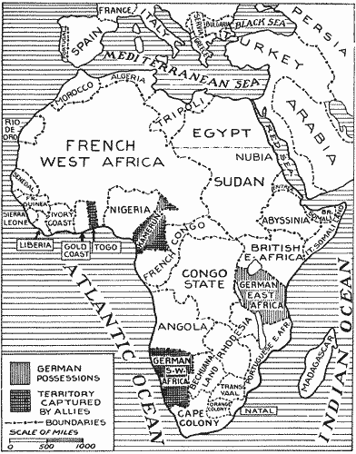
WW1: Africa & Asia join the party!
Colonial peoples…
drafted to serve Allies
worked to supply Allies
hoped freedom would follow Allied victory
German colonial possessions
in Pacific attacked & conquered by Japanese (Allies)
in Africa attacked by Allies & colonial peoples

Slide 16
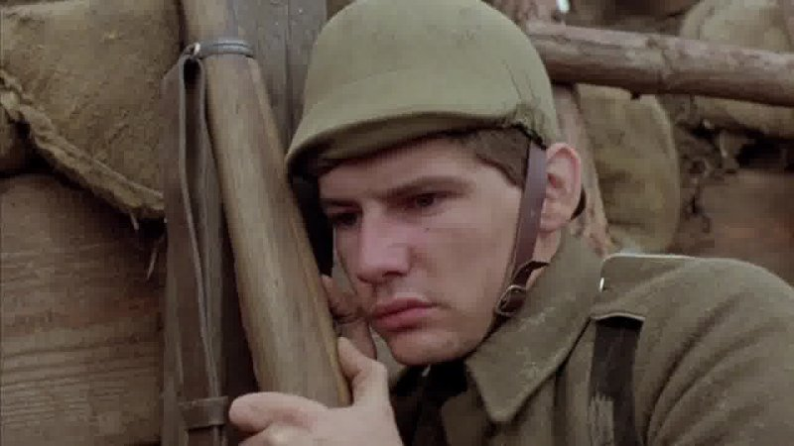
Quick! Create a Sensory Poem written by a soldier at the Front
I am…
I hear…
I see…
I smell…
I taste…
I feel…
I am…

Slide 17
WW1: What do you know so far?
Causes
?
?
Course
Who?
Turn Pts?
Predict
?
?
?
?
+ ?
When?
How?
Where?
?

Slide 18
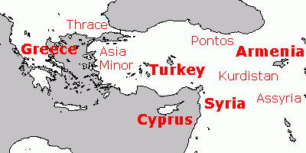
Ottoman Empire & the Armenians
Armenians one subgroup in the OE
Pressed for more rights…politically organized
Hamidian Massacres mid-1890s by Sultan
Western media reports + Mass emigration = Near East Relief
Young Turks…CUP overthrow sultan 1908
New Constitution >> Pan-Turkism policy
Ottoman lost land in Balkan Wars 1912-13
Ottoman def. by Russia early WW1
Armenian “collaborators?”… scapegoats
Spring 1915 mass murder & deportations…
Germans record… Armenian genocide & diaspora

Slide 19
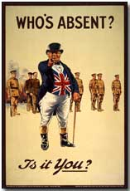
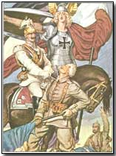
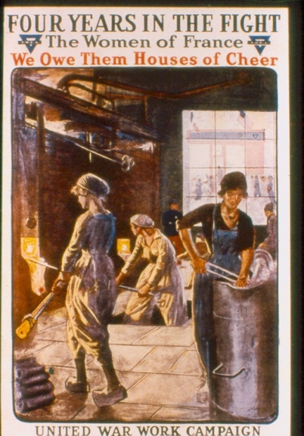
WW1 & Total War: What is It?
Government
Devotes all its resources to war effort
Controls economy
Conversion to war-time production
Rations supplies to civilians
Raises money via War Bonds
Controls information
Propaganda
Conscripts soldiers = “draft”

Slide 20
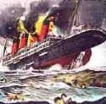
US Neutrality, was it?
US declared “neutrality”, but…
US sold supplies to both sides = $$
British blockade >> U-boat attacks
Lusitania
128 Americans die!
Arms were aboard!

Slide 21
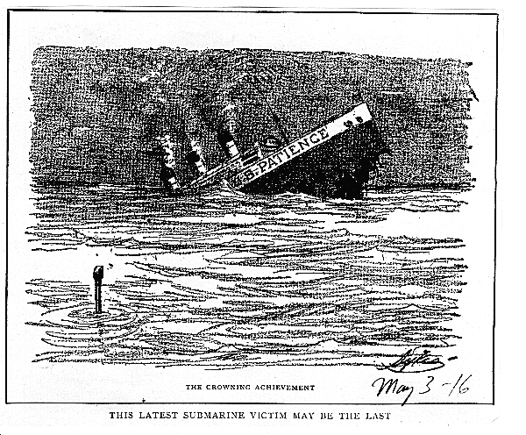
US Neutrality to Entry… why?
Lusitania ☹… US anger but no action
German Unrestricted Sub Warfare ☹
Lost Trade $$
Sussex Pledge ☹
Germany agrees
to warn
before sinking
and then…

Slide 22
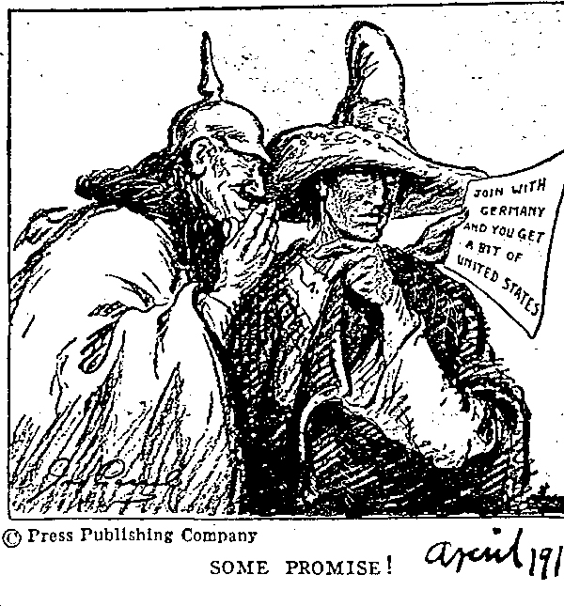
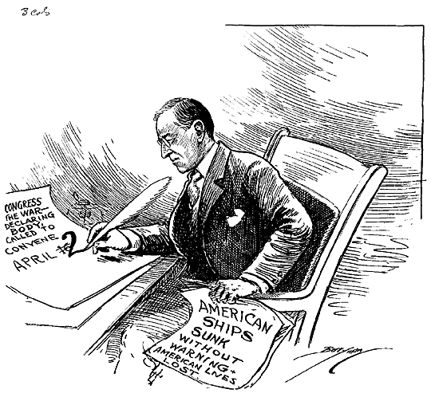
The Last Straw = US Entry!
The Zimmerman Note…
Germany tries to draw Mexico in on their side = US anger!!
Russian Revolution
March 1917 >> R pulls out!
US declares
& joins war
April 1917

Slide 23
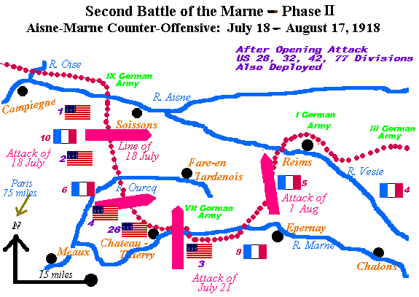
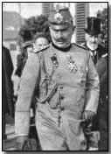
The Allies win WW1
Victory in doubt 1918, why?
G troops exhausted
French troops mutiny
2nd Battle of Marne
Last German offensive
US troops join war… Allies win
1918…the surrender dominoes…
Bulgaria…Ottoman Turks…A-H…
Riots in G, Kaiser abdicates…
11/11/1918 @ 11AM = armistice

Slide 24
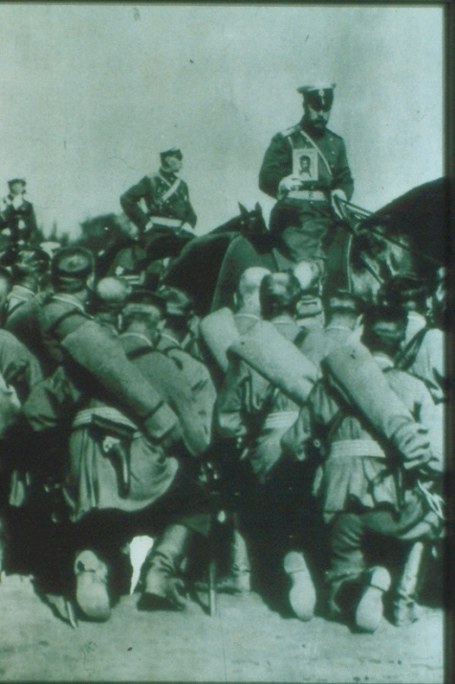
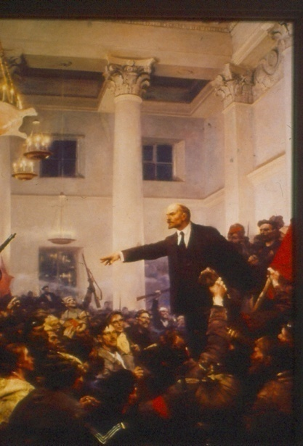
How did Russian Revolution effect WW1?
March 1917 Revolution
Czar Nicholas II abdicates
Provisional Government established
Alexander Kerensky… democracy?
Continue war despite heavy losses / shortages
November 1917 Revolution
G helps smuggle Lenin into Russia
Bolshevik coup d’etat
Treaty of Brest-Litovsk
Lenin / Russia withdraw from WW1
R cedes land to G in X∆ for peace
G sends troops to Western Front… 2nd Battle of Marne

Slide 25
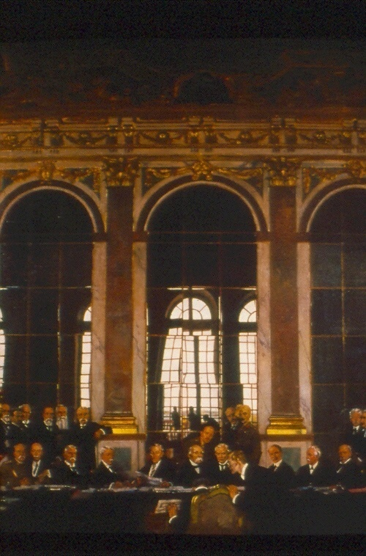
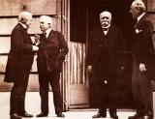
The Treaty of Versailles - 1919
The Big Four: Who are they?
Georges Clemenceau (F)
Lloyd George (GB)
Vittorio Orlando (I)
Woodrow Wilson (USA)… who’s missing?

Slide 26
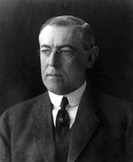
Treaty of Versailles(1919) What were the big ideas?
W Wilson & the Fourteen Points:
Self-determination & new nations,
Free seas & trade,
No secret treaties, adjusting colonies, arms reduction,
League of Nations
Did all Allies agree?

Slide 27
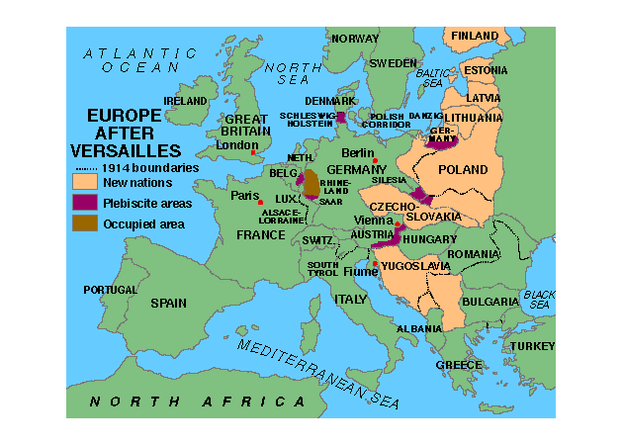
The Treaty of Versailles - 1919
The Results…
G lost land, war guilt clause & humiliation, reparations…
Mandates in Middle East…Turkey v. Armenia
New Nations in Europe, Polish Corridor
League of Nations… US does not join… the future?

Slide 28
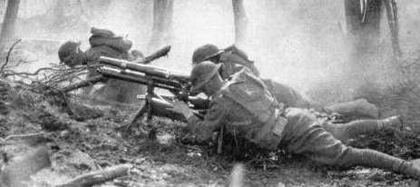
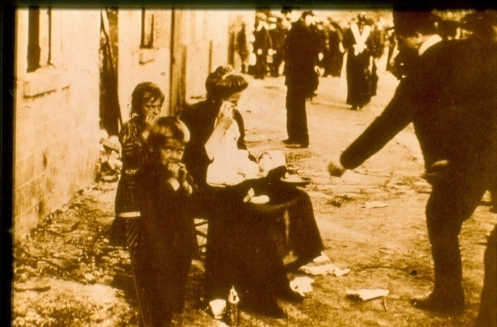
WW1: What was its “Legacy?”
New Technology = efficient killing
Global Conflict & global effects of war
Mass Death & destruction
Economic devastation of Europe
Rise of USA as a world economic & military power
1918 Influenza Epidemic… global death… 20 million worldwide
Austrian, German, Ottoman & Russian empires fall

Slide 29
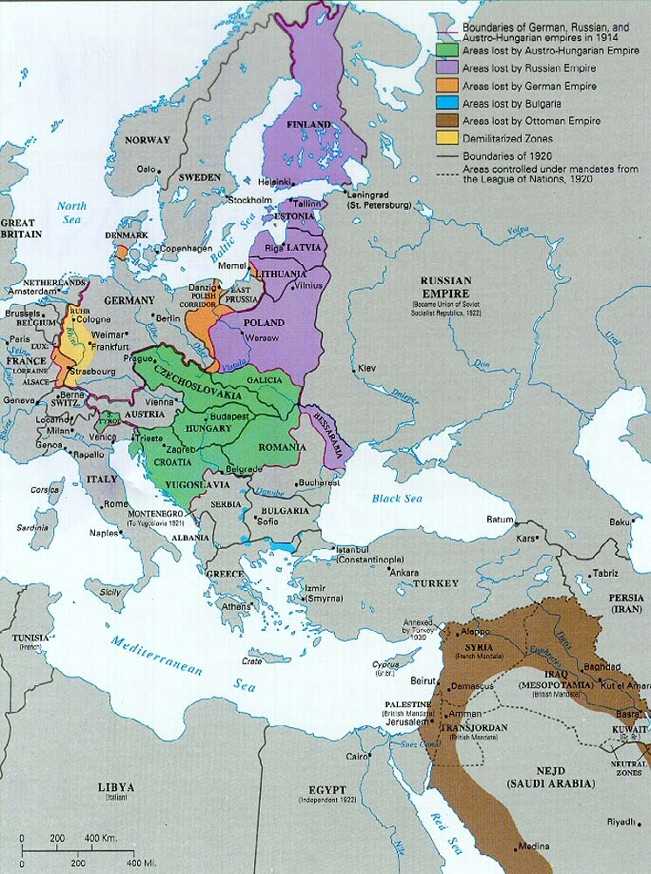
Post-WW1 Territory Changes: How did Europe change? What may result?

